Slide 1
ICPPA-2026 · MEPhI · GRAVITATION AND COSMOLOGY
Astronomical Tests of Spatial Anisotropy of Gravity
Lunar laser ranging and TNOs in the Spin-Density Model
Sergei Kupreev
RUDN University, Moscow
Jointly with Yury Razoumny
RUDN University
8th International Conference on Particle Physics and Astrophysics · Moscow · 27–30 October 2026
Notes:
[0:30]
Good afternoon. My name is Sergei Kupreev. I am from RUDN University in Moscow. This is joint work with Yury Razoumny. My talk is about gravity. I will show one simple idea. It links three problems of gravity. And I will show how to test it.
(RU) Добрый день. Я Сергей Купреев, РУДН. Работа совместно с Ю. Разумным. Одна идея связывает три проблемы гравитации; покажу, как её проверить.

Slide 2



MOTIVATION
Three open problems of gravity on three scales
The G problem
Distant TNOs
Rotation curves
Best experiments: 10–60 ppm uncertainty
Results scatter by ~500 ppm
CODATA inflates the errors by a factor of 3.9
Clustered orbits beyond 150–250 AU
Planet Nine (≈6 Earth masses, 380 AU) is still not found
Significance debated: selection effects
Flat curves: dark matter or modified gravity?
Tully–Fisher: v⁴ = GM·a₀ with one acceleration scale a₀
~500 ppm
≈ 6 M⊕
1.2·10⁻¹⁰
spread of G values
hypothetical planet, not found
m/s², universal acceleration scale
The Spin-Density Model offers one cause: the dynamics of the medium in which bodies interact
ICPPA-2026 · Moscow · 27–30 October 2026 · Sergei Kupreev, RUDN University
2
Notes:
[0:50]
Here are the three problems. First, the laboratory. We know the constant G very badly. The best experiments have errors of ten to sixty ppm. But the results differ by five hundred ppm.
Second, the edge of the Solar System. Very distant small bodies have strange orbits. Many people explain this with a new planet, Planet Nine. Nobody has found it.
Third, galaxies. Stars at the edge move too fast. Usually we explain this with dark matter. We think all three problems have one cause. Space is a medium.
(RU) G измерена плохо (разброс 500 ppm); странные орбиты далёких тел — «Планета Девять» не найдена; звёзды на краю галактик движутся слишком быстро. Причина одна: пространство — среда.

Slide 3
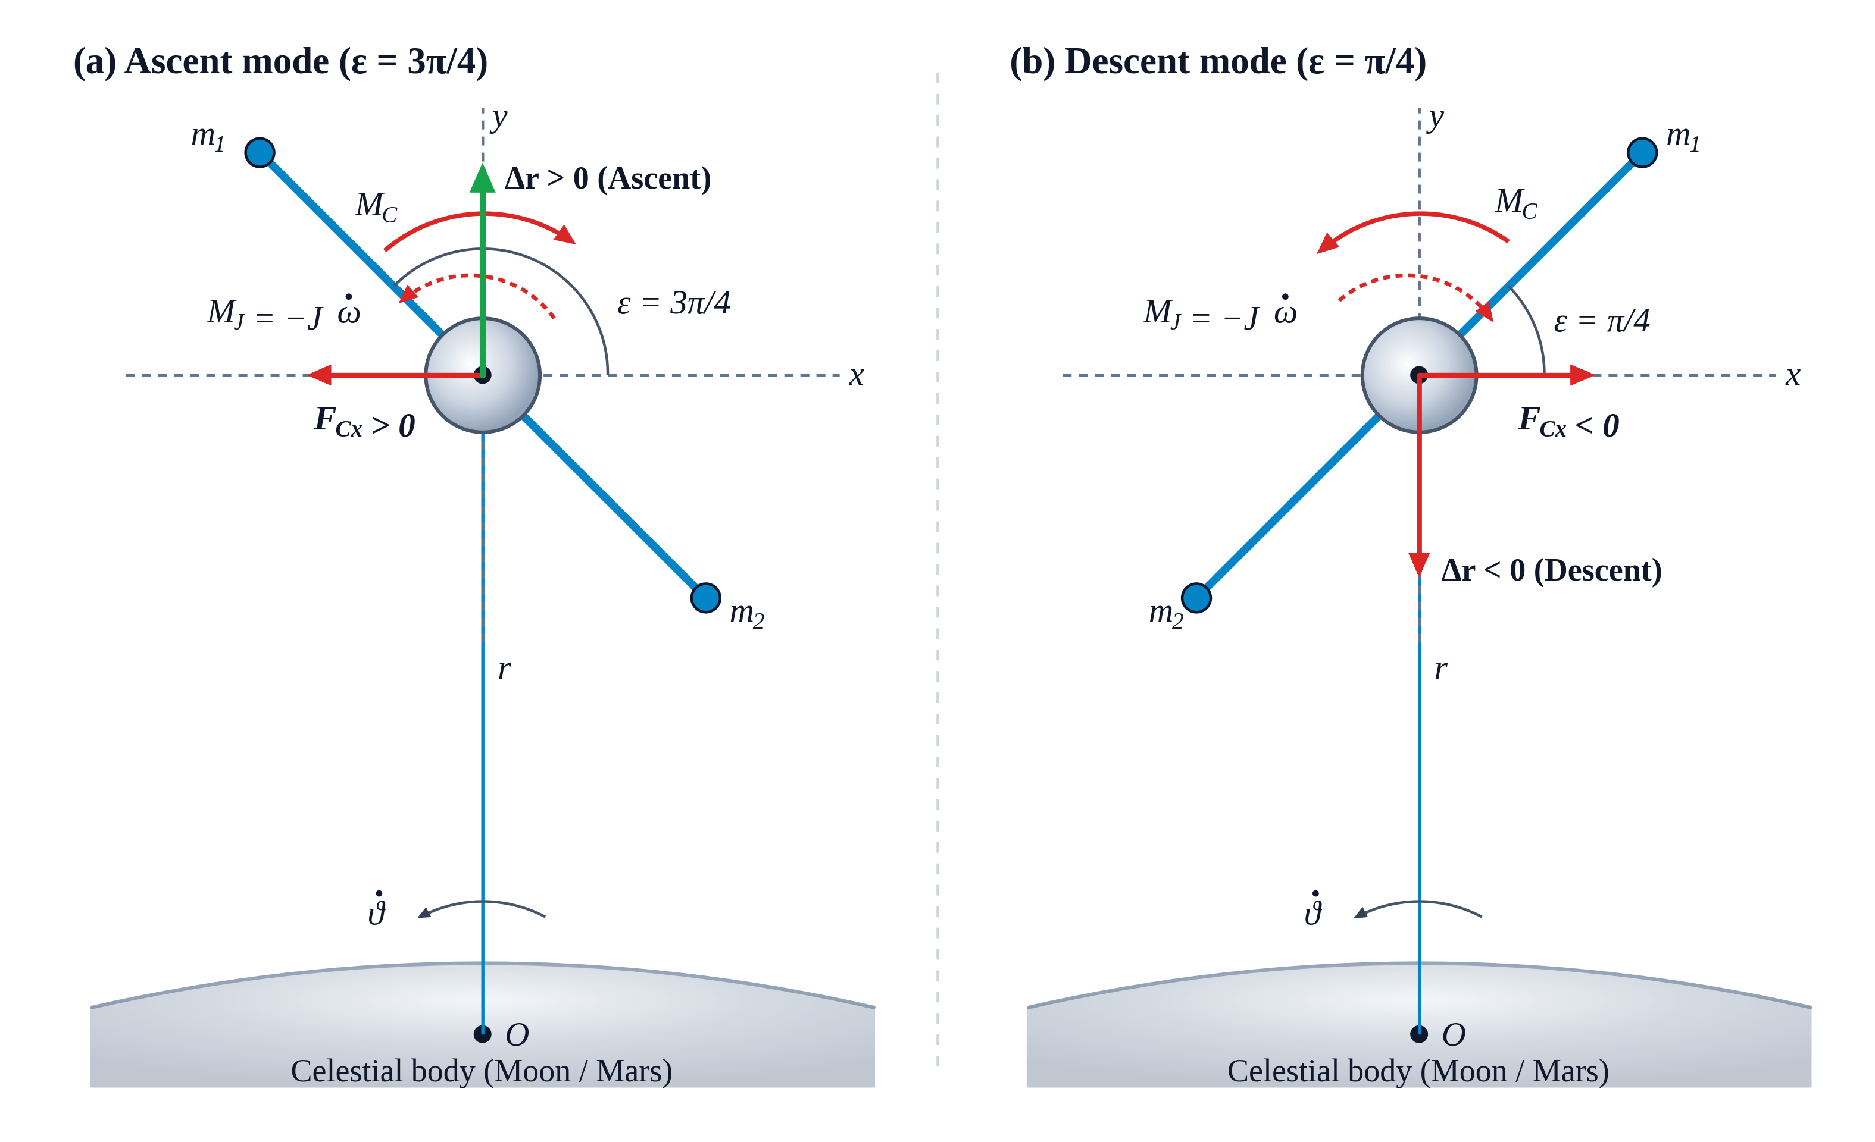

STEP 1 · CLASSICAL MECHANICS
Dumbbell + flywheel: orbit change without mass ejection
Conservation in a central field
Internal momentum K_{i} of the flywheel flows into orbital momentum K_{e} of the centre of mass.
D = 100 km at r = 6675 km: ±7 km per revolution.
From nature: the Moon recedes by 3.8 cm per year while the Earth’s spin slows down.
Centre of mass of the whole system is not shifted: conservation law is not broken.
Ascent: ε = 3π/4, flywheel spins up Descent: ε = π/4, flywheel brakes
ICPPA-2026 · Moscow · 27–30 October 2026 · Sergei Kupreev, RUDN University
3
Notes:
[0:40]
Let me start with simple mechanics. Here is a dumbbell with a flywheel in orbit. The flywheel spins up or slows down. Its angular momentum goes to the orbit. So the orbit changes. No fuel is used. The Moon does the same. It moves away from the Earth by four centimeters per year.
(RU) Гантель с маховиком: момент маховика переходит в орбиту, орбита меняется без топлива. Луна удаляется на 4 см в год.

Slide 4
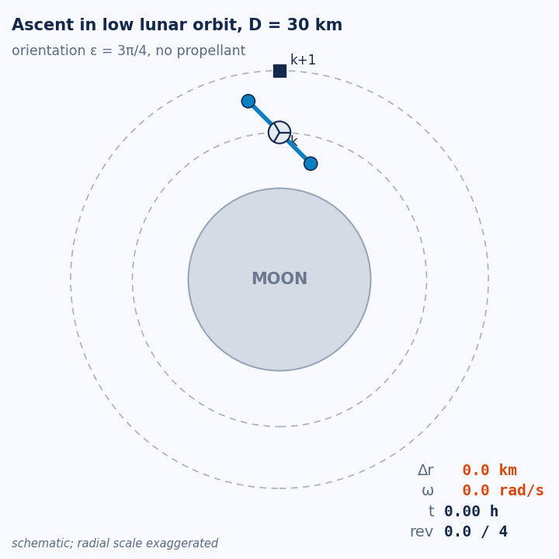
STEP 1 · ALREADY ENGINEERING
The Orbital Ferry: the classical principle at work
9 t of payload (20 t vehicle) raised by 23 km
low lunar orbit, dumbbell D = 30 km, 4 revolutions, about 8 hours
The same transfer (ΔV ≈ 10 m/s), our estimate:
System | Propellant | Energy
Chemical stage, Isp ≈ 320 s | ≈ 65 kg | chemical energy of the propellant
Electric tug, Isp ≈ 3000 s | ≈ 7 kg xenon | ≈ 1.4 MWh of electricity
Orbital Ferry | 0 kg | ≥ 90 kWh (orbital energy gain), from solar power; recovered by regeneration on the return leg
The limit:
the force scales as D²/r⁴. For an ordinary spacecraft (D ~ 10 m) it is 10–12 orders of magnitude below gravity.
ICPPA-2026 · Moscow · 27–30 October 2026 · Sergei Kupreev, RUDN University
4
Notes:
[0:30]
This is already engineering. A ferry in lunar orbit can lift nine tons by twenty-three kilometers in eight hours. Without fuel. But for a small spacecraft the force is too weak. So we go to the quantum level.
(RU) Орбитальный паром: 9 т на 23 км за 8 часов без топлива. Для малого аппарата сила мала — переходим к квантовому уровню.

Slide 5
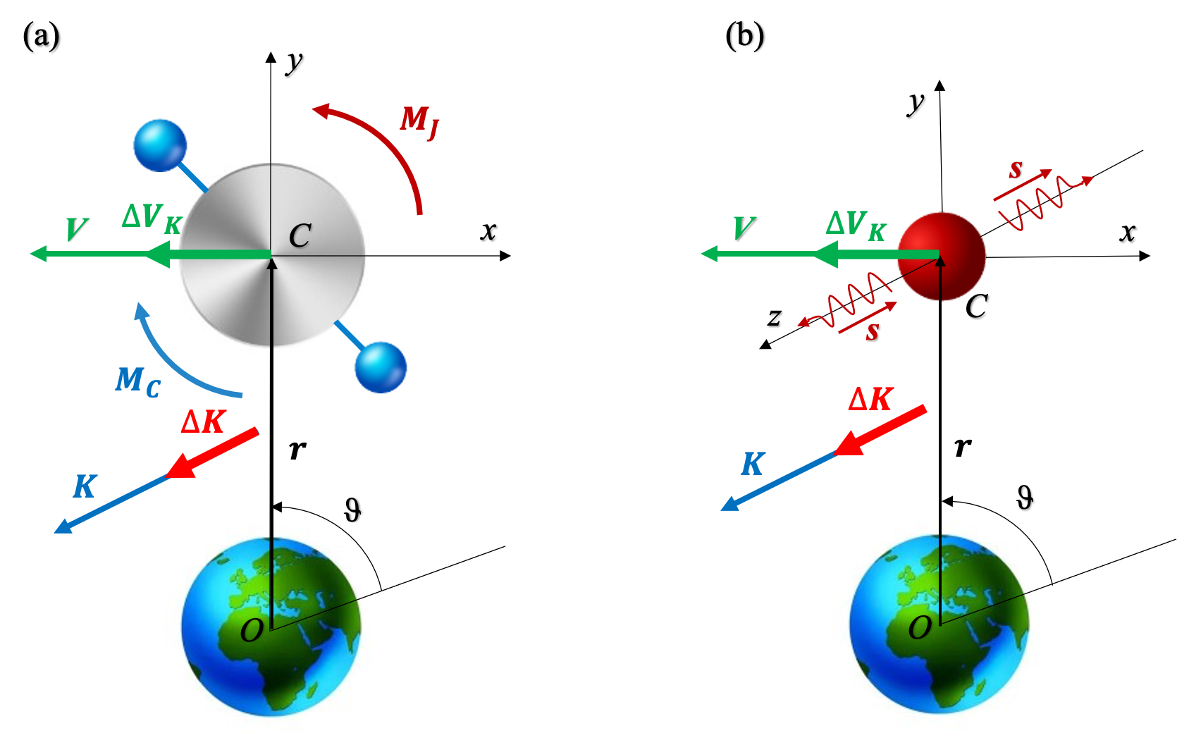

STEP 2 · QUANTUM EXTRAPOLATION
Spin as a quantum flywheel
n particles, spin sħ, local radius of trajectory curvature ρ_{U}
Spin is an intrinsic, indestructible angular momentum: a flywheel that nature gives for free.
The velocity change is orthogonal to the spin of the carriers.
Curvature is the lever
For ρ_{U} → ∞ (straight line) the effect vanishes. The old dogma “rotation cannot become translation” ignores the curvature of space.
(a) macroscopic flywheel (b) spin s of emitted / absorbed particles
ICPPA-2026 · Moscow · 27–30 October 2026 · Sergei Kupreev, RUDN University
5
Notes:
[0:40]
Spin is a quantum flywheel. It never stops. A body can emit or absorb particles with spin. If the path is curved, the velocity of the body changes. The curvature is the key. On a straight line there is no effect.
(RU) Спин — квантовый маховик. Испускание или поглощение частиц со спином на искривлённой траектории меняет скорость. Ключ — кривизна.

Slide 6

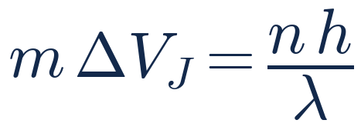
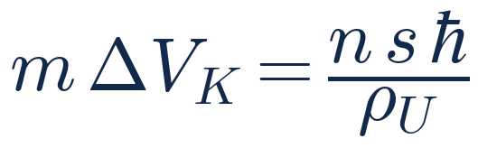
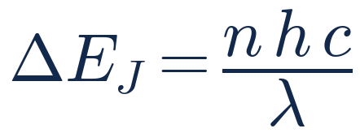
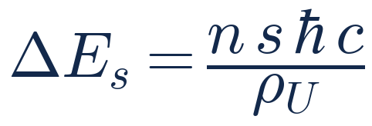
STEP 2 · ENERGY COMPARISON
Two channels to change velocity
Momentum channel
rocket, ideal photon rocket
Spin channel
emission / absorption of spin
Energy advantage
λ: Compton wavelength of the carrier
energy per unit momentum = c
cheaper when λ > 2πρ_{U}/s
1
Light carriers
large λ (low energy)
2
Strong curvature
small ρ_{U}
3
Why it was missed
physics studied high-energy particles (η ≲ 1) and the momentum channel only
ICPPA-2026 · Moscow · 27–30 October 2026 · Sergei Kupreev, RUDN University
6
Notes:
[0:30]
There are two ways to change velocity. The first way is a rocket. It throws mass out. The second way is spin. The spin way is cheaper, when the particles are light and the curvature is strong.
(RU) Два способа: ракета и спин. Спиновый дешевле для лёгких частиц и большой кривизны.

Slide 7
STEP 3 · DEEPENING THE PRINCIPLE
The smaller the scale, the cheaper the spin channel
10⁵⁰
at the Planck length: an extrapolation of the same formula
From planets to particles, the spin channel is always cheaper.
The smaller the radius of curvature, the larger the gain.
λ_{g} is a lower bound, so all values of η are lower bounds too.
ICPPA-2026 · Moscow · 27–30 October 2026 · Sergei Kupreev, RUDN University
7
Notes:
[0:20]
And the smaller the scale, the bigger the gain. At the smallest scale, the gain is ten to the power fifty.
(RU) Чем меньше масштаб, тем больше выигрыш — до 10^50. (Можно пропустить.)

Slide 8


FROM PRINCIPLE TO THEORY
The Spin-Density Model of space-time
1
A Lorentz-invariant medium
Space-time is a medium of light carrier particles with spin: not the old ether.
2
One postulate
Law of conservation of total carrier density: carriers are never created or destroyed, only redistributed between phases. All conservation laws follow from it.
3
Emergent physics
Gravity is a spin-pressure gradient, inertia a response of the medium, quantum fields its modes.
free
→
transit
→
bound
a free carrier bends and loops into matter
One medium instead of two worlds
Gravity (GR) and quantum fields (QFT) are not separate realities: they are phases and perturbations of the same carriers, driven by the same spin channel.
Law of conservation of total carrier density
ICPPA-2026 · Moscow · 27–30 October 2026 · Sergei Kupreev, RUDN University
8
Notes:
[0:45]
From this idea we build the Spin-Density Model. Space-time is a real medium. It is made of very light particles with spin. We call them carriers. Carriers have three states: free, transit and bound. Matter is made of bound carriers. There is only one law. The total number of carriers does not change.
(RU) Пространство-время — среда лёгких частиц со спином в трёх состояниях. Вещество — связанные носители. Один закон: число носителей сохраняется.

Slide 9
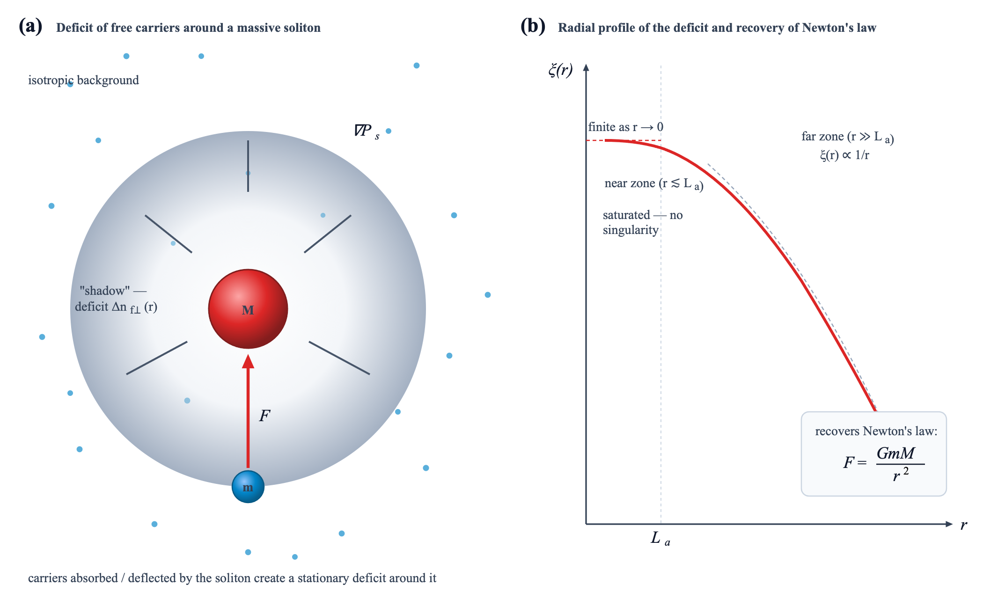
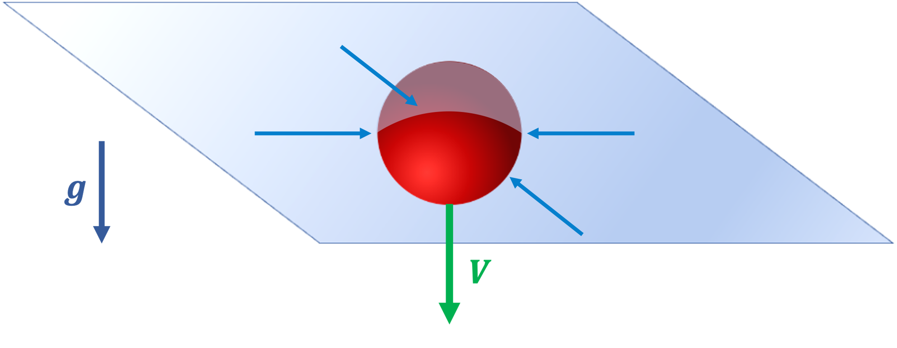
THE PRINCIPLE AT WORK
Gravity and inertia emerge from the medium
Inertia
Uniform motion: absorption and emission of carriers are balanced.
Acceleration: absorption in the plane across the motion responds at once, emission lags (τ ~ 10⁻²⁶ s). The imbalance resists the acceleration: F = ma.
Gravity
A mass captures useful carriers and leaves a “shadow” around itself. The spin-pressure gradient pushes bodies towards it: Newton’s law, and G follows from the medium.
Equivalence principle: both masses count the same bound carriers.
ICPPA-2026 · Moscow · 27–30 October 2026 · Sergei Kupreev, RUDN University
9
Notes:
[0:45]
Gravity comes from this medium. A mass absorbs carriers. So it makes a shadow around itself. The pressure of the carriers pushes other bodies into this shadow. This gives Newton's law. And the constant G depends on the medium. Inertia also comes from the medium. Remember one thing. If the number of useful carriers changes, gravity changes too.
(RU) Масса создаёт «тень», давление носителей толкает тела в неё — закон Ньютона, G зависит от среды. Меняется число полезных носителей — меняется гравитация.

Slide 10
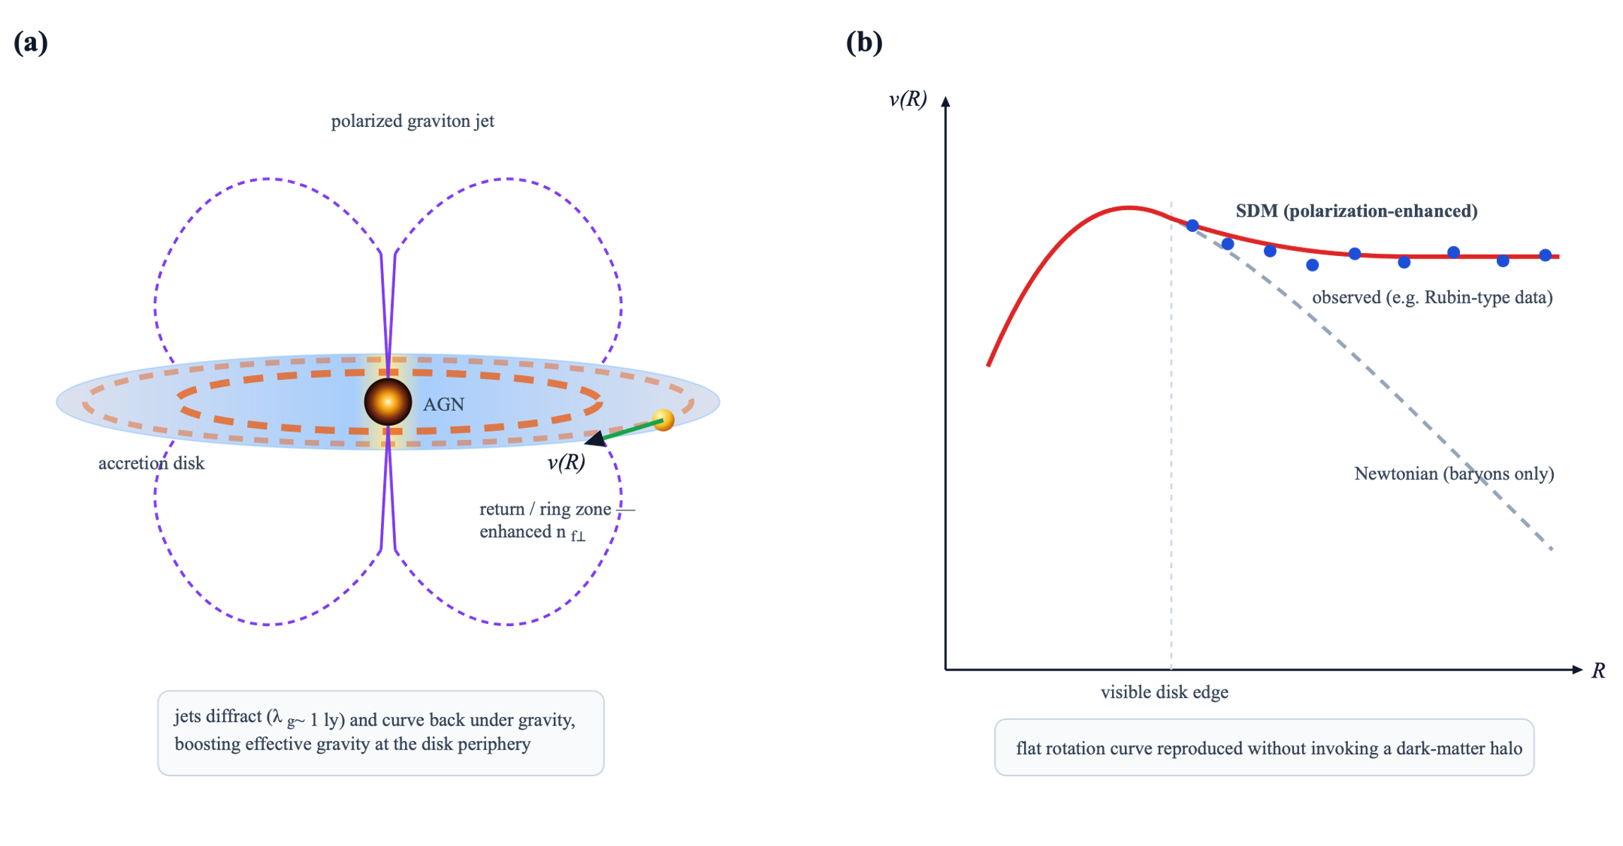
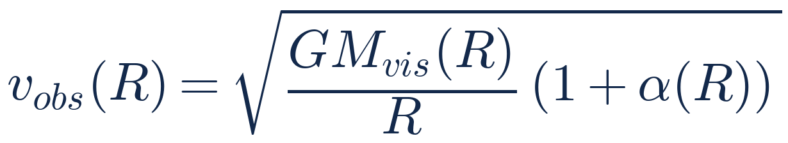
THE POLARIZED GALAXY · ROTATION CURVES
Flat rotation curves without a dark-matter halo
Open problems of ΛCDM
No direct detection of dark-matter particles
Missing satellites, cusp–core, too big to fail
Isolated quenched dwarfs in cosmic voids
SDM mechanism
1
AGN accretion disk emits polarized graviton jets along its axis
2
Diffraction (λ_{g} ~ 1 ly) and gravity return them to the disk in ring zones
3
Returning spins ⊥ disk raise useful-carrier density: effective gravity is enhanced
α(R) ∝ n_{f⊥}(R) / n_{f⊥}^{bg}
ICPPA-2026 · Moscow · 27–30 October 2026 · Sergei Kupreev, RUDN University
10
Notes:
[0:40]
Now the galaxies. Stars at the edge of a galaxy move too fast. Look at the right picture. The grey line is Newton, with visible matter only. The blue points are observations. They stay flat.
Usually, this is explained by a halo of dark matter. But dark matter particles are still not found.
In our model, the active nucleus of the galaxy sends out jets of polarized gravitons. They spread, bend and come back to the disk. They add useful carriers. So the attraction to the center is stronger, and the curve is flat.
(RU) Звёзды на краю галактик движутся слишком быстро: серая линия — Ньютон по видимому веществу, точки — наблюдения. Обычно это тёмная материя, но её частицы не найдены. У нас активное ядро излучает струи поляризованных гравитонов; они возвращаются в диск и добавляют полезные носители — притяжение к центру сильнее, кривая плоская.

Slide 11
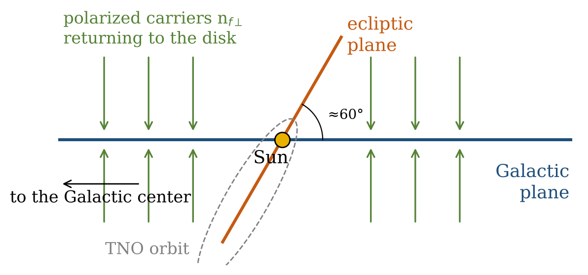
THE POLARIZED GALAXY · ANISOTROPY
The enhancement has a direction
1
Spin along the velocity
A free carrier has s = ±s₀v/c. Carriers crossing the disk along ẑ_{G} have spins parallel to ẑ_{G}.
2
Only the in-plane component
By the selectivity principle they transfer momentum only for changes of motion perpendicular to ẑ_{G}.
3
A conservative field
The extra field depends only on the distance d⊥ from the axis ẑ_{G}: a = −(GM/r²)n̂ − α(GM/d⊥²)ê⊥.
Polarized carriers return to the disk along its normal ẑ_{G}
The ecliptic is inclined to the Galactic plane by ≈60°: the Solar System feels a Galaxy-fixed, oblique anisotropy
ICPPA-2026 · Moscow · 27–30 October 2026 · Sergei Kupreev, RUDN University
11
Notes:
[0:40]
But this effect has a direction. A free carrier has its spin along its velocity. The carriers come back to the disk from above and from below. So they help only the motion in the plane of the galaxy.
The extra force depends only on the distance from this axis. So the field is conservative. Our Solar System is tilted to the plane of the galaxy by sixty degrees.
(RU) Эффект направленный: спин носителя направлен вдоль скорости, носители приходят в диск сверху и снизу и помогают только движению в плоскости Галактики. Добавочная сила зависит только от расстояния до оси — поле потенциально. Солнечная система наклонена на 60°.

Slide 12
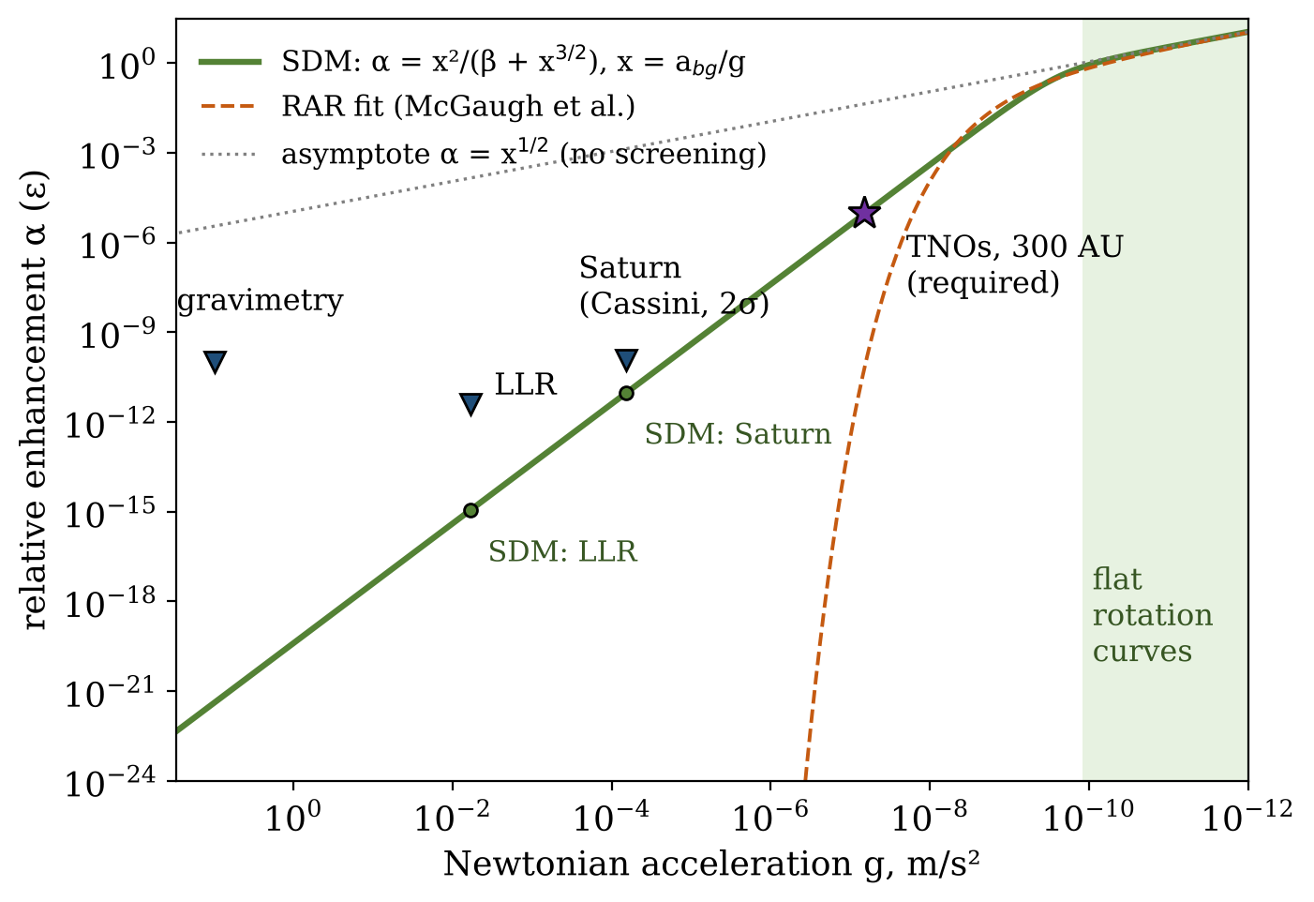

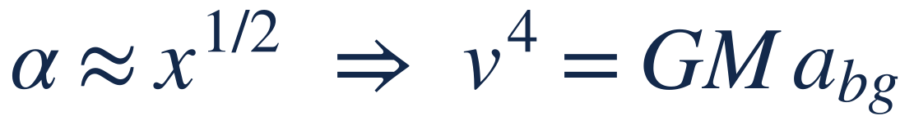
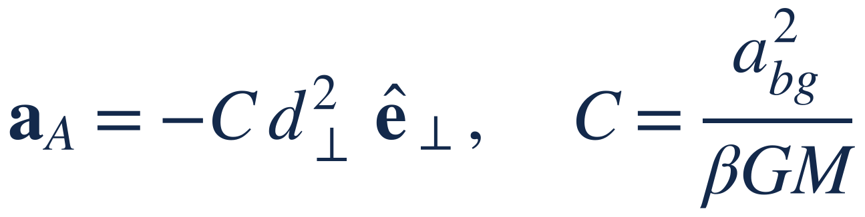
THE KEY LAW
Strong fields screen the enhancement
g ≪ a_{bg}: galaxies
flat curves, Tully–Fisher; radial acceleration relation within 15%
g ≫ a_{bg}: Solar System
a field growing as d²; relative effect ε ∝ d⁴
Two parameters: a_{bg} = 1.2·10⁻¹⁰ m/s² from galaxies, β ≈ 0.36 from TNOs — everything else is a prediction
ICPPA-2026 · Moscow · 27–30 October 2026 · Sergei Kupreev, RUDN University
12
Notes:
[1:10]
This is the main formula of my talk. Near the Sun, the field of the Sun is strong. The Sun hides the effect. We call this screening.
The effect depends on one number, x. x is the background acceleration, divided by the Newtonian acceleration.
In galaxies, x is large. Then we get flat rotation curves and the Tully-Fisher law. The orange dashed line is the observed relation. Our green line is close to it, within fifteen percent.
Near the Sun, x is small. The effect is very weak. It grows with distance, as the distance squared.
We have only two numbers. The first comes from galaxies. The second, beta, comes from the distant bodies.
(RU) Главная формула. Поле Солнца экранирует эффект. x = фоновое ускорение / ньютоновское. В галактиках x велико — плоские кривые и закон Талли–Фишера; оранжевый пунктир — наблюдаемая зависимость, наша кривая отличается не более чем на 15%. У Солнца эффект слабый и растёт как квадрат расстояния. Два параметра: один из галактик, β — из далёких тел.

Slide 13
FROM THE LABORATORY TO THE KUIPER BELT
Invisible nearby, decisive far away
System | g, m/s² | Constraint / data | SDM
Gravimeters | 9.8 | ΔG/G ≲ 10⁻¹⁰ | ε ~ 4·10⁻²²
Earth–Moon (LLR) | 6·10⁻³ | ΔG/G ≲ 4·10⁻¹² | ε ~ 1·10⁻¹⁵
Saturn (Cassini) | 6.5·10⁻⁵ | Q₂ = (1.6 ± 1.8)·10⁻²⁷ s⁻² | 9·10⁻²⁸ s⁻²
Saturn, density | 6.5·10⁻⁵ | ρ < 1.1·10⁻²⁰ g/cm³ | 1.5·10⁻²¹ g/cm³
TNOs, 300 AU | 7·10⁻⁸ | required ε ~ 10⁻⁵ | ε ≈ 9·10⁻⁶
Wide binaries | ~2·10⁻¹⁰ | boost 1.0 vs 1.43 ± 0.06 | 1.25–1.4
Galactic outskirts | ≲ 10⁻¹⁰ | radial acceleration relation | within 15%
CASSINI AT SATURN
9·10⁻²⁸ s⁻²
SDM tidal gradient at Saturn, inside the Cassini bound (1.6 ± 1.8)·10⁻²⁷
Within one order of magnitude: improved INPOP / EPM / DE ephemerides will confirm or exclude β ≈ 0.36.
An unscreened ΔG/G ~ 10⁻⁸ is excluded; LLR and gravimetry are null tests, the outer planets decide
ICPPA-2026 · Moscow · 27–30 October 2026 · Sergei Kupreev, RUDN University
13
Notes:
[1:00]
This table is the main result. The same formula gives the effect for every scale.
For gravimeters on the Earth, it is ten to the minus twenty-two. For the Moon, it is ten to the minus fifteen. Nobody can see it. So laser ranging to the Moon is a null test.
The important place is Saturn. The Cassini spacecraft gives a limit. Our value is inside this limit, but only ten times smaller. So better orbits of the outer planets will confirm our model, or reject it.
For the distant bodies, we get ten to the minus five. This is exactly what they need.
(RU) Одна формула для всех масштабов: гравиметры 10⁻²², Луна 10⁻¹⁵ — не видно, LLR — нулевой тест. Важен Сатурн: наше значение внутри предела Cassini, но лишь в 10 раз меньше — уточнённые эфемериды внешних планет подтвердят или опровергнут модель. Для далёких тел 10⁻⁵ — ровно сколько нужно.

Slide 14
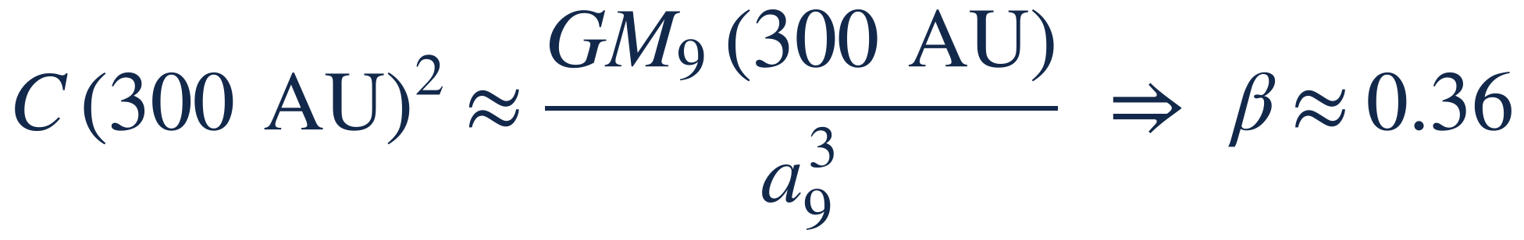
TRANS-NEPTUNIAN OBJECTS
The polarization field as an alternative to Planet Nine
Required strength
What the field can and cannot do
At 300 AU the field must equal the Planet Nine tidal acceleration GM₉d/a₉³ ≈ 6·10⁻¹³ m/s²:
1
Can: cluster orbital planes
Laplace surface between the ecliptic and the Galactic plane: poles and nodes cluster about the Galactic pole
2
Can: lift perihelia
Kozai cycles in the Galactic frame give detached objects (Sedna, 2012 VP₁₁₃)
Secular dynamics
τ ≈ 9·10⁷ yr at a = 300 AU
Precession rate ∝ a^{5/2} (Planet Nine: a^{3/2})
β is an order-of-magnitude value: numerical integration is needed
3
Cannot: one-sided perihelia
The field is even, so it gives no one-sided clustering of perihelia
4
No unseen body
Searches for Planet Nine stay empty; wide binaries boosted by 25–40%
LSST at the Rubin Observatory: orbital poles in Galactic coordinates and the detached population — a decisive test
ICPPA-2026 · Moscow · 27–30 October 2026 · Sergei Kupreev, RUDN University
14
Notes:
[1:10]
Now the distant bodies, beyond Neptune. Some of their orbits are grouped. Many people explain this with Planet Nine. Our field can do a similar job. At three hundred AU it must be as strong as the pull of Planet Nine. This gives beta about zero point three six. The orbits change slowly, in about ninety million years.
What can our field do? It can group the planes of the orbits around the pole of the galaxy. And it can lift the closest points of the orbits far from Neptune. This gives detached objects, like Sedna.
What can it not do? It cannot group the perihelia on one side. Here Planet Nine is stronger. The new survey, L-S-S-T, will show if this grouping is real.
(RU) Наше поле — альтернатива «Планете Девять»: при β ≈ 0,36 его сила на 300 а.е. равна притяжению планеты, время эволюции ~90 млн лет. Может: группировать плоскости орбит вокруг полюса Галактики и поднимать перигелии (отделённые объекты, Седна). Не может: одностороннюю кластеризацию перигелиев — здесь гипотеза «Планеты Девять» сильнее. LSST покажет, реальна ли эта кластеризация.

Slide 15
LABORATORY SCALE · MEDIATED INTERACTION
Mediated interaction and the Parallel Fall test
1
A wake in the medium
An accelerating mass disturbs the balance of carriers around it. It leaves a spin-density wake: a deficit of useful carriers.
Heavy ball
50–200 kg
Oscillator
0.1 kg, Q > 10⁶
Vacuum tower
10–20 m, ~1.5 s of fall
2
Action at a distance through the medium
A nearby body inside the wake exchanges carriers differently. Its oscillation period and quality factor change: mediated interaction.
g
3
A clear signature
The effect exists only while the mass accelerates, grows with its mass, and vanishes for a light dummy ball.
Expected signal:
a step change of the oscillator quality factor, ΔQ/Q₀ ~ 10⁻⁶–10⁻⁸, exactly during the fall. Within reach of laser interferometry.
Both fall together: direct forces are minimal
ICPPA-2026 · Moscow · 27–30 October 2026 · Sergei Kupreev, RUDN University
15
Notes:
[0:40]
Now back to the laboratory. Here the medium gives a second effect. When a heavy mass accelerates, it leaves a wake in the medium. A body near this wake changes its oscillation. We propose a simple test. Two bodies fall together in a vacuum tower.
(RU) Ускоряющаяся масса оставляет след; соседнее тело меняет колебания. Тест — совместное падение в вакуумной башне. (Можно сократить.)

Slide 16
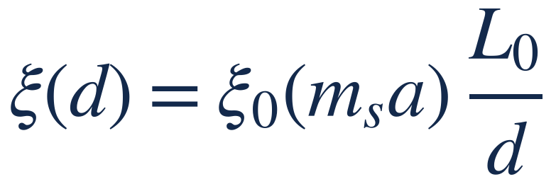

LABORATORY SCALE · THE G PROBLEM
Accumulated wakes may make the measured G site-dependent
Experiment | Regime of motion of masses | G, 10⁻¹¹ SI | ppm
CODATA 2022 | recommended value | 6.67430(15) | 22
HUST 2018, TOS | pendulum oscillations | 6.674184(78) | 11.6
HUST 2018, AAF | rotation, angular-acceleration feedback | 6.674484(78) | 11.6
BIPM 2013 | static + electrostatic servo | 6.67545(18) | 27
NIST 2026 | BIPM apparatus at a new site | 6.67387(38) | 57
Rosi et al. 2014 | atom interferometry, free fall | 6.67191(99) | 150
Accumulated wakes
Slow relaxation of the medium: wakes of all moved masses add up around the apparatus
Ξ depends on the regime of motion, the site and the history — not on the material
BIPM apparatus moved to NIST: 235 ppm lower; Cu and sapphire masses agree
Decisive test: identical apparatuses at two sites, and before / after a change of operating regime
ICPPA-2026 · Moscow · 27–30 October 2026 · Sergei Kupreev, RUDN University
16
Notes:
[1:00]
This wake may also explain the problem with G. Look at the table. The experiments move the masses in different ways.
We think that the medium relaxes slowly. Then the wakes of all moved masses add up around the apparatus. They change the result.
One fact supports this. The BIPM apparatus was moved to NIST. There it gave a value two hundred thirty-five ppm lower. But two different materials gave the same result.
Our prediction: G depends on how the masses move, on the place, and on the history of the apparatus. It does not depend on the material.
(RU) След может объяснить и проблему G. Если среда релаксирует медленно, следы всех перемещённых масс накапливаются вокруг установки. Факт: установка BIPM, перевезённая в NIST, дала значение на 235 ppm меньше, а медь и сапфир дали одинаковый результат. Прогноз: G зависит от режима движения масс, места и истории установки, но не от материала.

Slide 17



HOW TO TEST IT
A test program on three scales
Laboratory
Ephemerides and LLR
TNOs and beyond
Identical G apparatuses at two sites
G before and after a change of regime
Correlation with vibration and traffic
Ephemeris fit: field (7), axis ẑG, one parameter β
Saturn–Neptune: within ×10 of Cassini
LLR, gravimetry: null tests (ε ≲ 10⁻¹⁵)
Orbital poles in Galactic coordinates (LSST)
Detached population; numerical integration
Wide binaries (25–40%) and comets
Each test can refute the model: an ephemeris bound below 9·10⁻²⁸ s⁻² at Saturn excludes β ≈ 0.36
ICPPA-2026 · Moscow · 27–30 October 2026 · Sergei Kupreev, RUDN University
17
Notes:
[0:40]
So, how can we test the model? In the laboratory, we measure G with two identical apparatuses at two places. With the planets, we fit their orbits with our field. Saturn and Neptune will decide. With the distant bodies, we check the planes of their orbits with the new survey. Each test can reject the model.
(RU) Проверка: лаборатория (две одинаковые установки в разных местах), планеты (подгонка орбит с нашим полем — решают Сатурн и Нептун), далёкие тела (плоскости орбит по новому обзору). Каждый тест может опровергнуть модель.

Slide 18
CONCLUSIONS
One medium, three scales
1
Screened anisotropy
Enhancement only ⊥ ẑ_{G}, screened by strong fields: α = x²/(β + x^{3/2}), x = a_{bg}/g.
2
Galaxies
For g ≪ a_{bg}: flat rotation curves, v⁴ = GMa_{bg}, radial acceleration relation within 15%.
3
Solar System
A conservative field growing as d²: ε ~ 10⁻¹⁵ at the Moon, inside the Cassini bound at Saturn.
4
Trans-Neptunian objects
β ≈ 0.36: clustered orbital planes and detached objects without an unseen body; not one-sided perihelia.
5
Laboratory G
Accumulated wakes: G depends on regime, site and history of the apparatus, not on material.
6
Decisive tests
Outer-planet ephemerides, TNO poles with LSST, wide binaries, G at two sites.
ICPPA-2026 · Moscow · 27–30 October 2026 · Sergei Kupreev, RUDN University
18
Notes:
[0:40]
To conclude. One medium explains three problems. In galaxies, it gives flat rotation curves. At the edge of the Solar System, it is an alternative to Planet Nine. It explains the grouped orbit planes, but not the grouped perihelia. In the laboratory, it can explain the spread of G. And all this can be tested soon.
(RU) Одна среда — три проблемы: кривые вращения; альтернатива «Планете Девять» (группирование плоскостей орбит, но не перигелиев); разброс G. Всё проверяемо в ближайшие годы.

Slide 19

Thank you
Questions, criticism and joint tests are welcome.
Sergei Kupreev · kupreev-sa@rudn.ru
Yury Razoumny · RUDN University, Moscow. Paper submitted to the ICPPA-2026 proceedings.
ICPPA-2026 · Moscow · 27–30 October 2026 · Sergei Kupreev, RUDN University
19
Notes:
[0:10]
Thank you for your attention. I am ready for your questions.
(RU) Спасибо за внимание. Готов ответить на вопросы.

Slide 20
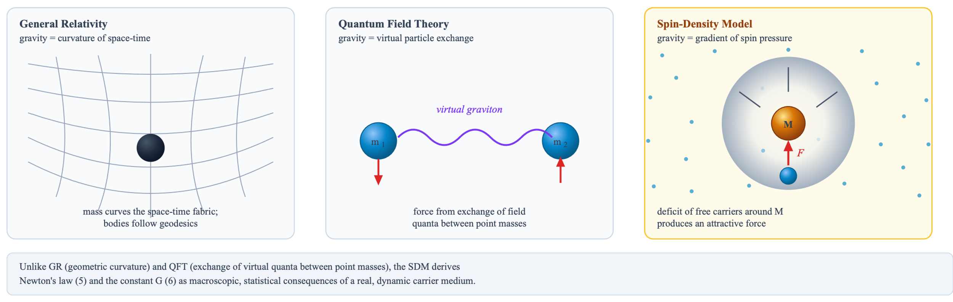
BACKUP · WHAT IS A FORCE?
Three pictures of gravity: GR, QFT and SDM
General Relativity
Force is geometry: mass curves space-time. Deterministic, classical.
Quantum Field Theory
Force is an exchange of virtual quanta between point particles. Probabilistic, discrete.
Spin-Density Model
Force is a spin-pressure gradient in a real medium, the spin channel at work.
ICPPA-2026 · Moscow · 27–30 October 2026 · Sergei Kupreev, RUDN University
20
Notes:
Backup slide. (RU) Запасной слайд для ответов на вопросы.

Slide 21
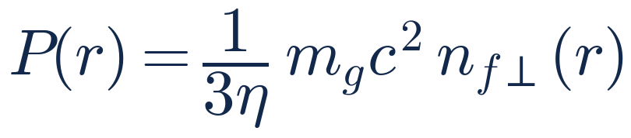
BACKUP · UNDERSTANDING THE FORCES
Why gravity is so weak and electricity is so strong
~10⁴²
Coulomb vs. gravitational force between two electrons
Gravity
smooth soliton surface
Electricity
“rough” soliton surface
The same carriers, the same mechanism: only the coherence and orientation of the carrier flux differ.
Only tangential carriers exchange spin: q ≈ 10⁻²⁶
Acts on all matter: universal
η in the denominator of the spin pressure
Roughness drives vortices in the medium: the electric field
Sign of charge = direction of the vortex
Coherent exchange: q → 1; acts only on charged particles
The enormous efficiency η of the spin channel is compensated in gravity by its tiny selectivity; in electromagnetism the flux is coherent, so the force is strong.
ICPPA-2026 · Moscow · 27–30 October 2026 · Sergei Kupreev, RUDN University
21
Notes:
Backup slide. (RU) Запасной слайд для ответов на вопросы.

Slide 22
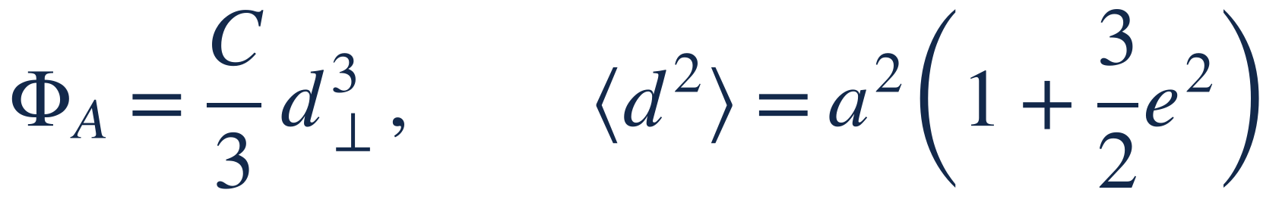
BACKUP · SECULAR DYNAMICS
Orbit-averaged polarization field
Potential of the field (7) and its orbit average (aphelion parts dominate)
Distinctive scaling of the precession rate (tidal approximation)
Conserved quantity and time scale
With J₂ of the giant planets: a warped Laplace surface between the ecliptic and the Galactic plane; Kozai cycles lift perihelia.
Even in the eccentricity vector: planes and perihelion distances evolve, but no one-sided clustering of perihelia
ICPPA-2026 · Moscow · 27–30 October 2026 · Sergei Kupreev, RUDN University
22
Notes:
Backup slide. (RU) Запасной слайд для ответов на вопросы.

Slide 23
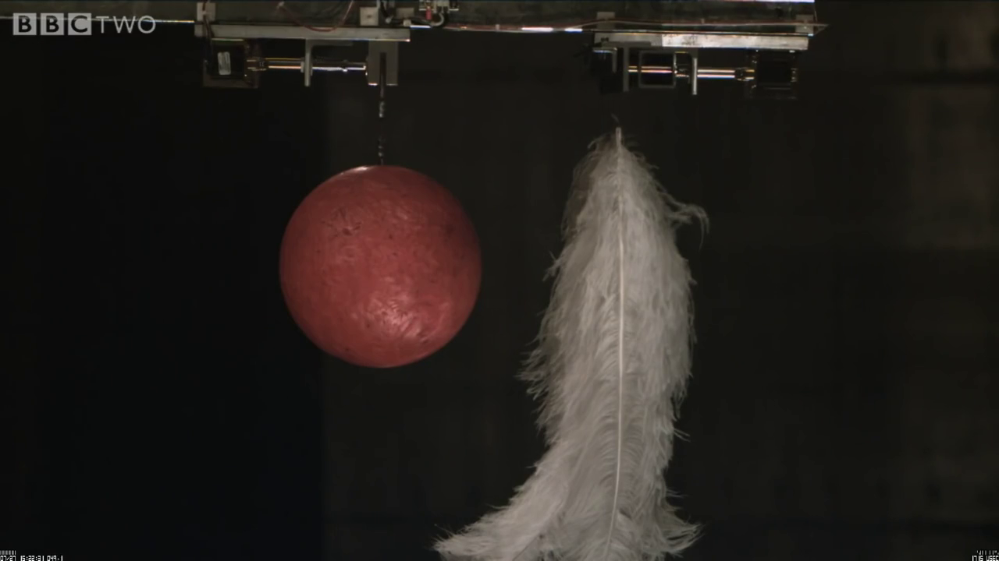
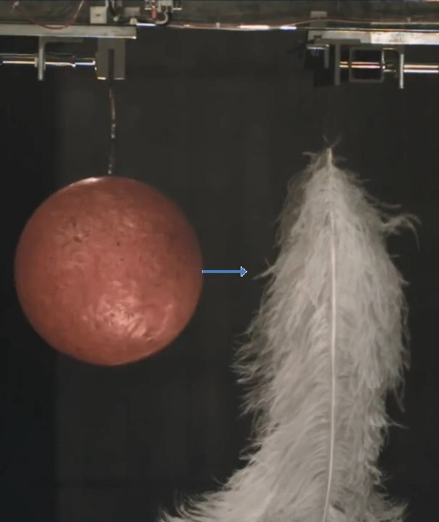
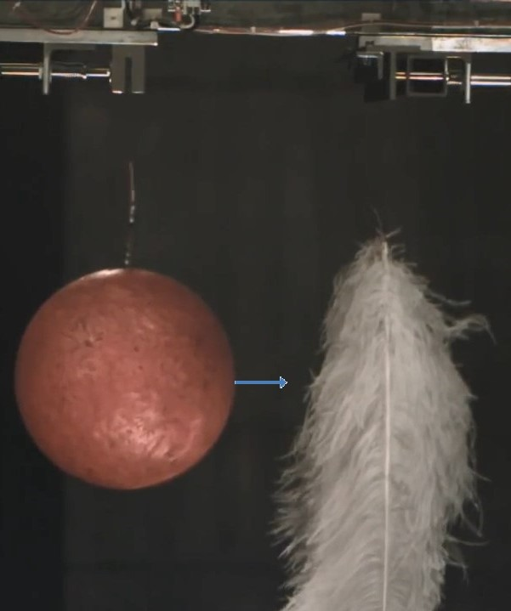
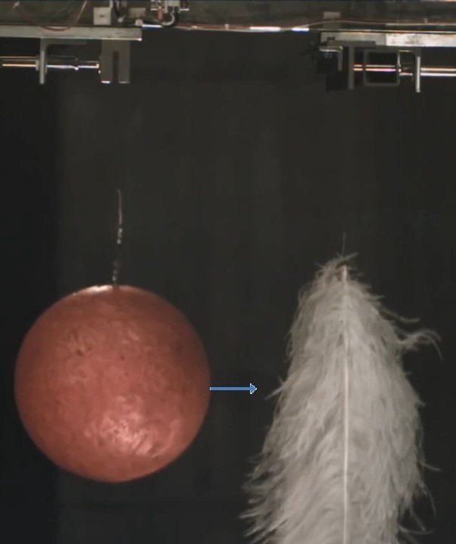
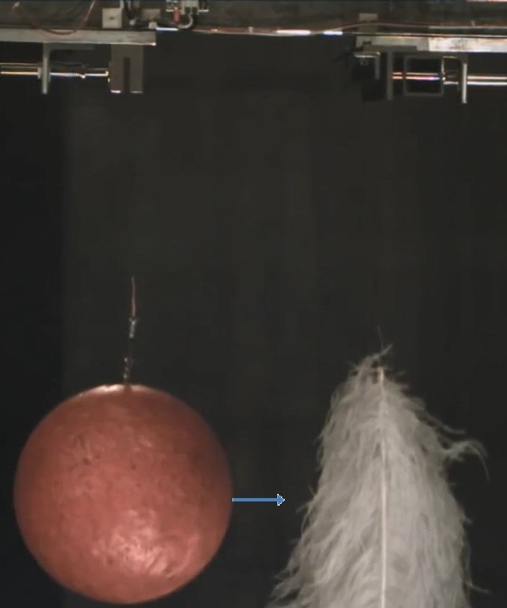
BACKUP · PILOT OBSERVATION
Ball and feather falling in the NASA vacuum chamber
(Brian Cox, 2014)
NASA Space Power Facility, Ohio; footage: B. Cox, BBC Two
Fibres facing the ball’s centre move differently (arrows). In the model, the accelerating ball absorbs carriers in its horizontal plane. This creates a deficit of useful carriers near the fibres and changes their oscillation: mediated interaction.
ICPPA-2026 · Moscow · 27–30 October 2026 · Sergei Kupreev, RUDN University
23
Notes:
Backup slide. (RU) Запасной слайд для ответов на вопросы.

Slide 24
BACKUP · THE SERIES
Five parts from the principle to the theory
1
2
3
4
5
PART 1
From reactive thrust to a new paradigm of motion
dumbbell–flywheel, spin mechanism, η, pilot drop tests
PART 2
Newton’s law from medium dynamics
three phases, selectivity, spin pressure, emergent G
PART 3
Inertia and mediated interaction
F = ma, equivalence principle, spin-density wakes, Parallel Fall
PART 4
Emergent geometry and astronomical verification
Einstein equations, dark matter as polarisation, azimuthal asymmetry
PART 5
Emergent quantum field theory
gauge bosons, solitons, charges, gauge invariance, entanglement
More information
ICPPA-2026 paper
Physics of Atomic Nuclei (submitted)
Preprint 2026
doi:10.13140/RG.2.2.16274.93121
IAC 2026
D3.2B · x111964; D4.4 · x112361
ICPPA-2026 · Moscow · 27–30 October 2026 · Sergei Kupreev, RUDN University
24
Notes:
Backup slide. (RU) Запасной слайд для ответов на вопросы.

