Slide 1







NRC «Kurchatov Institute»
Asymmetric fission in heavy-ion
collisions
A.A. Kulikovskaya, B.M. Abramov, S.A. Bulychjov, I.A. Dukhovskoy,
V.V. Kulikov, M.A. Martemianov, M.A. Matsyuk
The 8th International Conference on Particle Physics and Astrophysics (ICPPA 2026)
Moscow, 27−30 October 2026
Notes:
1

Slide 2
Outline
The physics problem: testing nucleus-nucleus interaction models is an important part of heavy ion physics. It is well known and experimentally proofed that at small momentum transfer in nuclear fragmentation of projectile the momentum spectra of fragments have a gaus-like peaks with the maximum at a velocity equal to the projectile velocity and width equal to predictions of statistical Goldhaber approach based on Fermi motion in the projectile.
But as was shown by GSI-FRS experiment (1 GeV/nucl., ⁵⁶Fe on a proton target) it is not always true. For light fragments emitted at very small angles, a double-humped shape of fragmentation peaks was observed. They interpreted this effect as a manifestation of a new mechanism of asymmetric fission. They also found that this effect disappear at titanium target
In the FRAGM experiment we confirmed the existence of this effect in light fragment yield in ⁵⁶Fe + ⁹Be collisions at 230 MeV/n and now will present new data at heavier target
A comparison with predictions of a few models of nucleus-nucleus interactions will be also done
Notes:
2

Slide 3
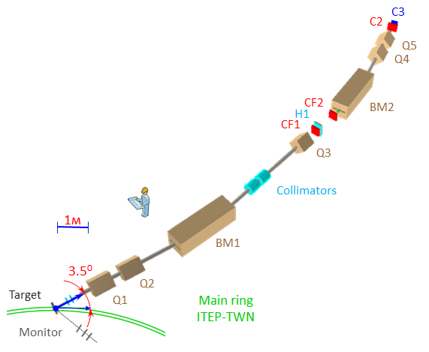
Experimental setup FRAGM
Second focus
Data were collected on the heavy ion accelerator complex TWAC with ¹²C ions at different energies of 300, 600, 950, 2000, 3200 MeV/nucleon and with ⁵⁶Fe ions at energy of 230 MeV/nucleon
Measurements were performed on different targets: ⁹Be, ²⁷Al, ⁶⁴Cu
Total channel length: 42 m
Two bending magnets: BM1 (bending angle: α = 0.259 rad.), BM2 (α = 0.276 rad.)
Five quadrupoles: Q1, Q5 (vertical focusing) и Q2, Q3, Q4 (horizontal focusing)
First focus
Scintillation counters: CF1, CF2, C2, C3 (dE/dx, TOF)
СF1 − C2 coincidence gives trigger signal
H1 − hodoscope consisting from 20 vertical elements (scintillation counters, size 20×1×1 cm)
Beam monitoring system consists of three scintillation counters located at angle of 2° relative to the beam line
TWAC Main ring
[A. A. Kulikovskaya, et al., Phys. At. Nucl. 85, № 9, 1541 (2022) ]
Notes:
3

Slide 4
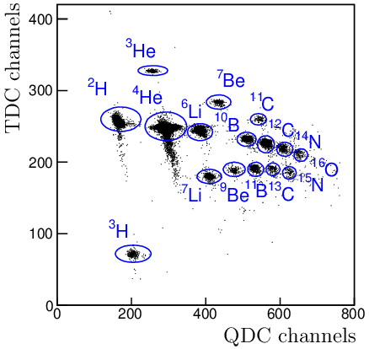
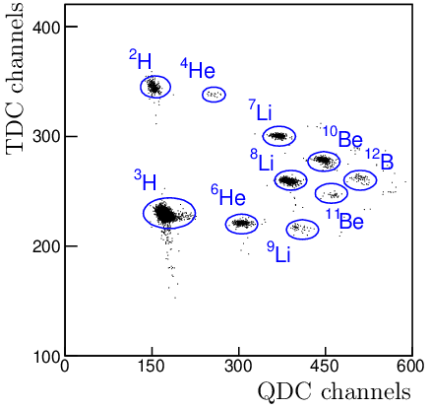
Fragment identification in the FRAGM experiment
Rigidity (p / Z) : 1.3 ГэВ/c
Rigidity (p / Z) : 1.8 ГэВ/c
Magneto-optical channel tuning: the magnetic spectrometer channel was tuned to a specific magnetic rigidity (p/Z ratio) for each experimental run to select the rigidity of the fragments
Two-dimensional correlation distribution: fragment identification is performed using the correlation between QDC channels and TDC channels
QDC Axis: ionization losses (dE/dx) using the CF1 scintillation counter to determine the fragment charge (Z)
TDC Axis: time-of-flight (TOF) between the CF1 and C2, which is a function of the fragment mass
[A. A. Kulikovskaya, et al., Phys. At. Nucl. 85, № 9, 1541 (2022)]
Notes:
4

Slide 5
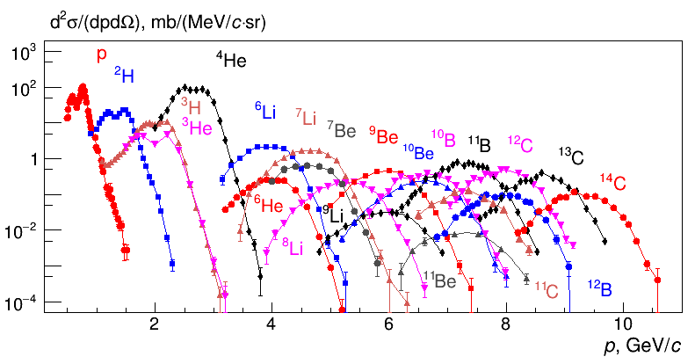
Light fragments as a function of momentum
⁹Be - target
Measured cross-sections: the plot shows differential cross-sections for light fragments from protons up to ¹⁴C
Detection limits: heavier fragments (up to ⁵⁶Fe) are not registered due to large ionization losses at first focus that increase as Z square
Data are normalized to the total cross-section using the LAQGSM framework (1547 mb). Detection efficiency depends on momentum and is calculated via a precise model of the magneto-optical channel.
Heavy fragments: show a standard Gaussian-like peak, where the width is determined by Fermi motion in the projectile nucleus (described by the Goldhaber formula)
Light fragments: a splitting of the fragmentation peaks into two humps are clearly seen. It is the main result of this work
Notes:
5

Slide 6
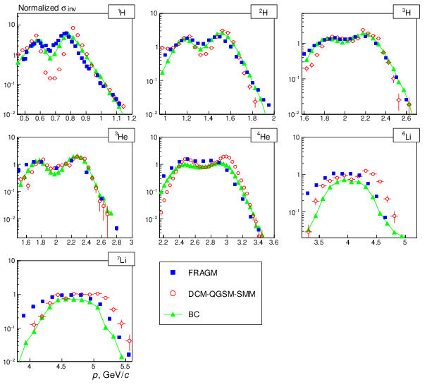
Peak splitting effect in nucleus-nucleus interaction models
The splitting effect is observed for all light fragments below lithium isotopes and it decreases as the fragment mass increases.
Compared Models: Experimental data are compared with two nucleus-nucleus interaction models such as BC (Binary Cascade) and DCM-QGSM-SMM (Dubna Cascade Model combined with Quark-Gluon String and Statistical Multifragmentation Models) which is actively developed at JINR
Both models qualitatively predict the peak-splitting structure, though they estimate its magnitude and shape differently.
  However, both frameworks fail to show quantitative agreement with the FRAGM data, significantly mismatching the experimental cross-section values.
  DCM-QGSM-SMM provides a noticeably better description of the peak structure and shapes compared to the BC model
Notes:
6

Slide 7
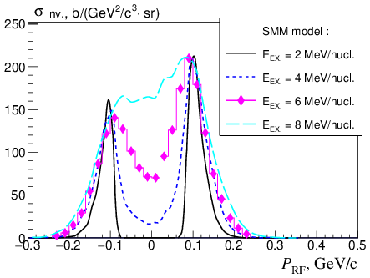
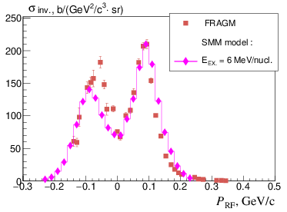
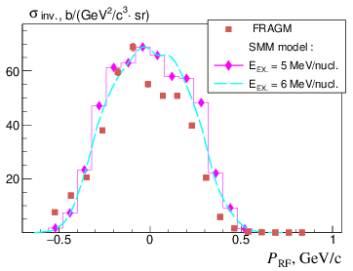
Peak splitting shape and multifragmentation
¹H
¹H
Model input parameter: the statistical multifragmentation model (SMM) uses the excitation energy of the excited projectile remnant as its primary input parameter
Qualitative mechanism: at small momentum transfers, the excited projectile undergoes an asymmetric break-up. The light fragment emitted forward is accelerated by the Coulomb field of the heavy spectator remnant, while the fragment emitted backward is decelerated, causing the peak to split
Quantitative SMM approach: quantitatively, the SMM does not require an explicit asymmetric fission mechanism. The asymmetric partitions and the resulting peak-splitting shapes are reproduced purely statistically via phase-space weights inside the freeze-out volume. The shape of the fragment momentum spectrum serves as a direct probe for the internal state of the excited nucleus
The best fit to our experimental data is achieved at an excitation energy of 6 MeV/nucleon
⁴He
Notes:
7

Slide 8
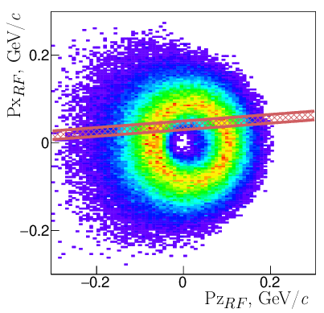

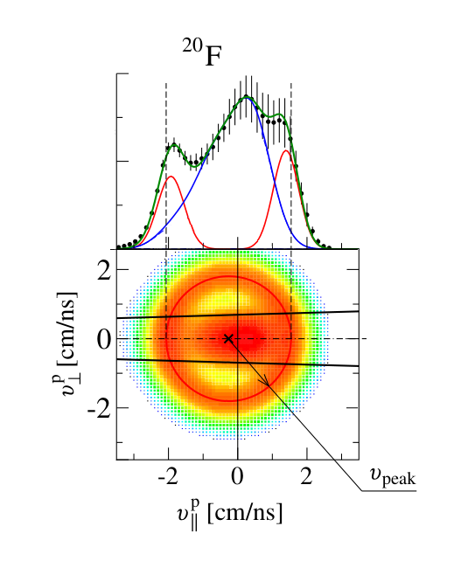
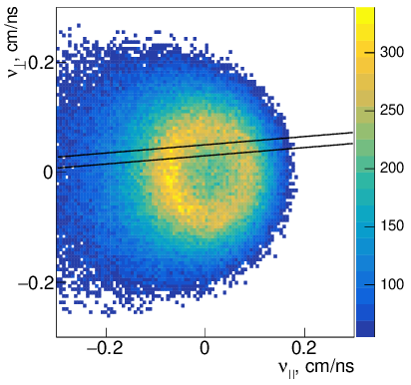
Velocity space topography & asymmetric decay models
Multifragmentation
protons
Coulomb part
Angle acceptance FRAGM
FRAGM predictions (left): Inside the FRAGM angle acceptance, the Binary Cascade (BC) model predicts a highly symmetrical spatial velocity pattern for emitted protons
The FRS data and baseline model (right): To illustrate the velocity topology, we refer to the classic FRS−GSI framework by
P. Napolitani et al. Phys. Rev. C, 2004
The Coulomb ring feature: data for the ¹³⁶Xe + proton system shows that velocity vectors populate a hollow sphere (ring cut) due to strong Coulomb repulsion
Peak origin: The forward-backward peak splitting is formed by the superposition of the expanding multifragmentation component and the asymmetric Coulomb acceleration. Comparing these patterns helps evaluate why the standard cascade approach (BC) fails to reproduce the distinct asymmetric velocity profiles observed experimentally
Notes:
8

Slide 9
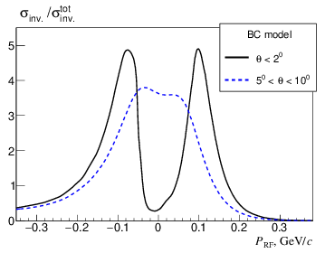
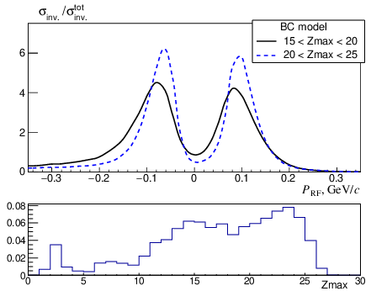
Description of the effect in the model predictions
Plotted observables: the vertical axis displays the normalized invariant momentum distribution of protons in arbitrary units, corrected for dimensions
Angular dependence (left): calculations within the Binary Cascade (BC) model for ⁵⁶Fe fragmentation at 230 MeV/nucleon show that the peak-splitting effect strongly dominates at small forward angles (below 2⁰) and completely disappears at angles greater than 5⁰
Residual charge dependence (right): the top-right plot shows the proton momentum distribution grouped by the charge of the spectator fragment. The BC model shows only a minor dependence of the peak shape on the residual charge
Origin of the Zmax histogram: The bottom histogram displays the calculated charge distribution of the heaviest remaining fragment (Zmax) produced immediately after the cascade stage in the BC model simulation
Notes:
9

Slide 10
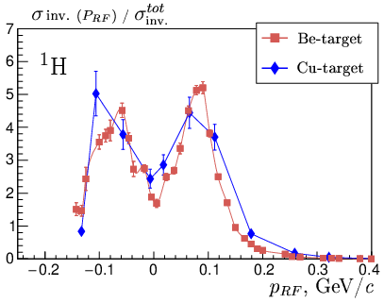
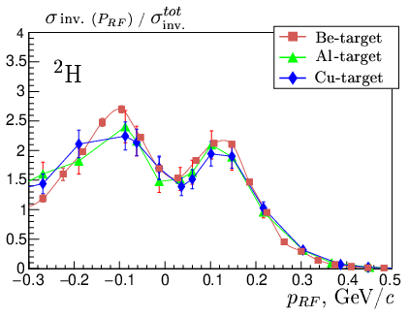
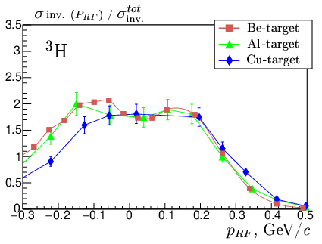
Effect of the peak splitting on different targets
First presentation of new data: experimental invariant cross-sections of light fragment production on ²⁷Al and ⁶⁴Cu targets are presented for the first time
Plotted observables: the plots display the normalized invariant cross-section for light fragments as a function of longitudinal momentum, measured in the rest frame of the incident iron nucleus
Normalization: data distributions for all three targets are normalized to their integrated cross-sections to allow a direct shape comparison
Target independence: The shape and magnitude of the peak-splitting effect are in agreement for all three targets (⁹Be, ²⁷Al, ⁶⁴Cu), clearly demonstrating that this effect is independent of the target atomic number
Notes:
10

Slide 11
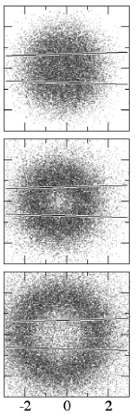
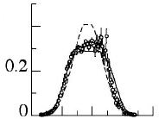
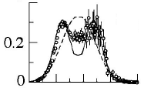
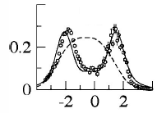
Experimental data from GSI-FRS
FRS, ⁵⁶Fe + p
¹²C
Similar experimental data were obtained in the GSI-FRS experiment at the SIS heavy-ion synchrotron
Experimental data were obtained on the fragmentation of ⁵⁶Fe at an energy of 1 GeV/nucleon on various targets (hydrogen, titanium, etc.)
The detector was constructed as a magnetic spectrometer, which made it possible to measure the velocity β with high accuracy
A wide range of fragments heavier than ⁶Li were detected, where the distortion of the spectrum shape was most clear seen
It is assumed that the peak splitting effect is due to the process of asymmetric fission of the projectile nucleus
The influence of Coulomb forces in the nuclear fragmentation does not make a significant contribution to the process of asymmetric nuclear fission
Main paper : P. Napolitani et al. Phys. Rev. C 70, 054607 (2004)
¹⁰B
Capture angle
⁶Li
⁵⁶Fe fragmentation on hydrogen target;
(β|| , β⊥) in the rest frame of incident nucleus
Velocity spectra in the rest frame
Notes:
11

Slide 12
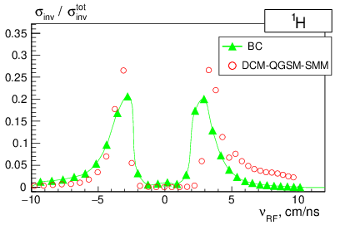
Experimental data from GSI-FRS
models, ⁵⁶Fe + p
Measurements were performed using ⁵⁶Fe and ¹³⁶Xe beams at an energy of 1 GeV/nucleon on a cryogenic hydrogen target
The angular acceptance of the FRS was limited to a narrow forward cone of 15 mrad (0.86⁰) relative to the beam axis
The high-resolution fragment separator allowed for high-precision particle velocity measurements
The setup was restricted to registering fragments with a nuclear charge Z greater than or equal to 3
Model predictions for protons: while FRS could not directly measure the lightest residues, model predictions (BC and DCM-QGSM-SMM) indicate that the peak-splitting effect remains clearly visible for protons as well
The momentum peak-splitting effect was observed for the first time at GSI using the FRS setup and was originally attributed to a novel mechanism of highly asymmetric nuclear fission
Main paper: P. Napolitani et al. Phys. Rev. C 70, 054607 (2004)
Notes:
12

Slide 13
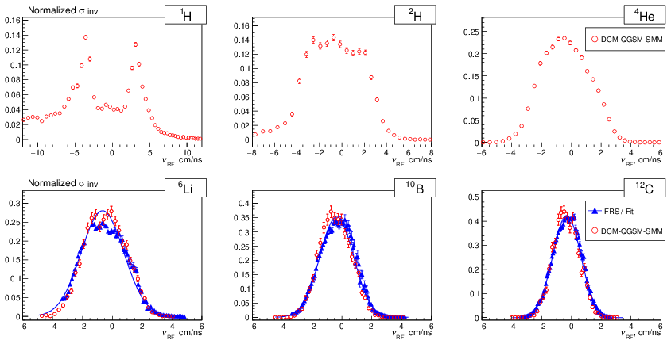
DCM-QGSM-SMM model and GSI-FRS data on ⁴⁸Ti target
The ohysical phenomenon: a key question is how the peak-splitting effect manifests on a heavy target. The FRS−GSI experiment showed that the splitting effect completely disappears when using a titanium target
Plotted curves: the charts present the normalized invariant cross-section versus fragment velocity, measured in the rest frame of the incident iron nucleus
Model performance & interpretation: the advanced DCM-QGSM-SMM model shows excellent quantitative agreement with the experimental FRS data
At an incident beam energy of 1 GeV/nucleon, the model correctly predicts the absence of the peak-splitting effect for ⁴He and heavier fragments
In this energy regime, the statistical multifragmentation pathway successfully explains both the existence of peak-splitting for light protons on heavy targets (as seen at FRAGM) and its disappearance for heavier residues (as seen at FRS)
Notes:
13

Slide 14
Conclusions
Experimental scope: fragment yields from ⁵⁶Fe fragmentation at 230 MeV/nucleon were successfully measured on three targets (⁹Be, ²⁷Al, ⁶⁴Cu) using the FRAGM setup at the TWAC complex (NRC «Kurchatov Institute»)
Observed peak-splitting: a distinct momentum peak-splitting effect was observed for light fragments (A less than 4). The effect is most pronounced for protons and systematically decreases with increasing fragment mass
New findings on target independence: for the first time, it is demonstrated that the peak-splitting shape and magnitude for light fragments persist on heavy targets and remain independent of the target atomic numbtarge
The formation of the split momentum profile is governed by Coulomb repulsion combined with statistical multifragmentation processes
Mechanism insight: In contrast to the explicit dynamic asymmetric fission mechanism proposed for high-energy FRS data, our results are successfully reproduced within the SMM framework purely statistically
Model parameter tuning: the SMM model accurately describes the peak-splitting shape as a function of the source excitation energy. The best fit to our experimental data determines this energy value to be 6 MeV/nucleon
Angular & charge studies: the shape of the proton momentum distribution was comprehensively investigated and found to depend heavily on the fragment emission angle and the residual charge of the spectator nucleus
Notes:
14

Slide 15
Thank for attention
Notes:
15

Slide 16
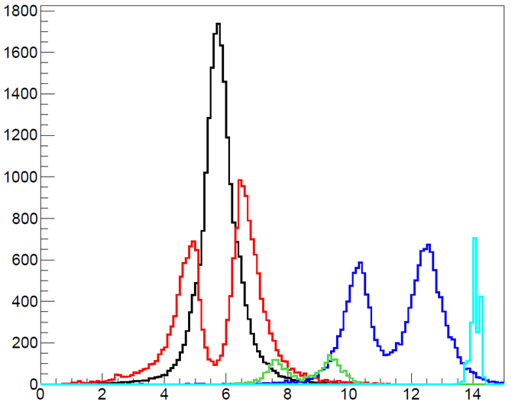
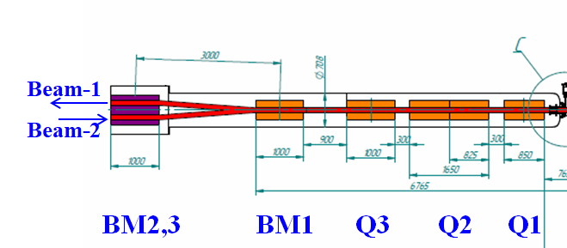
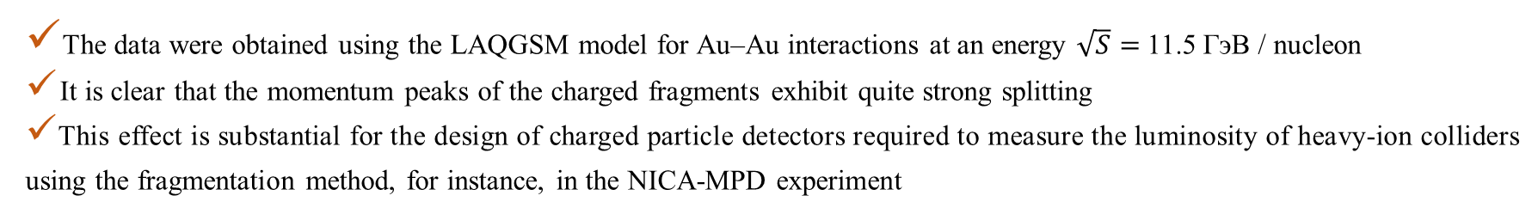
The peak splitting effect in luminosity measurement
Лучше сделать этот слайд запасным, итак достаточно материала
Sсheme of the luminosity measurement for NICA collider
neutrons
Θ < 0.01 рад.
Beam-1
Beam-2
MPD
detector
protons
¹⁹²Au
²H
Charged
fragment
detector
³He
- Ø10 cm collimators
p / z, GeV / с
The data were obtained using the LAQGSM model for Au–Au interactions at an energy $\sqrt{S}=$11.5 ГэВ / nucleon
It is clear that the momentum peaks of the charged fragments exhibit quite strong splitting
This effect is substantial for the design of charged particle detectors required to measure the luminosity of heavy-ion colliders using the fragmentation method, for instance, in the NICA-MPD experiment
Notes:
16

Slide 17
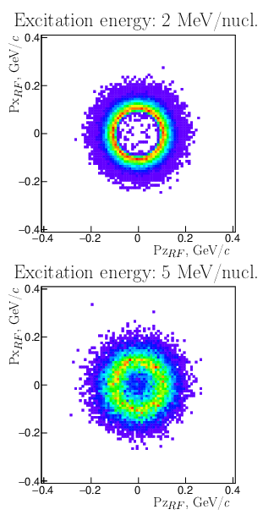
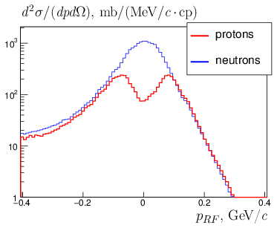
Protons splitting effect in the nucleus-nucleus interaction models
BC
SMM
Angular acceptance of the FRAGM setup
SMM
Coulomb effect /
ВС model
Notes:
17

