Slide 1
Pyroelectric accelerator with quasimonoenergetic electron production: current status and challenges
A.N. Oleinik^{1,*}, M.O. Berezhnaya¹, I.A. Kishchin^{1,2}, A.A. Klenin¹, A.A. Podoynitsyn¹, I.S. Shablov^{1,3}, P.G. Shapovalov^{1,4}, V.S. Sotnikova¹
¹ Laboratory of Radiation Physics, Belgorod National Research University, Belgorod, Russia
² Lebedev Physical Institute, Moscow, Russia
³ Shubnikov Institute of Crystallography of the Kurchatov Research Center, Moscow, Russia
⁴ National Research Nuclear University ”MEPhI“, Moscow, Russia
^{*)} oleynik_a@bsuedu.ru
Report at the 8th International Conference on Particle Physics and Astrophysics (ICPPA-2026)
Moscow, 30th of October, 2026

Slide 2
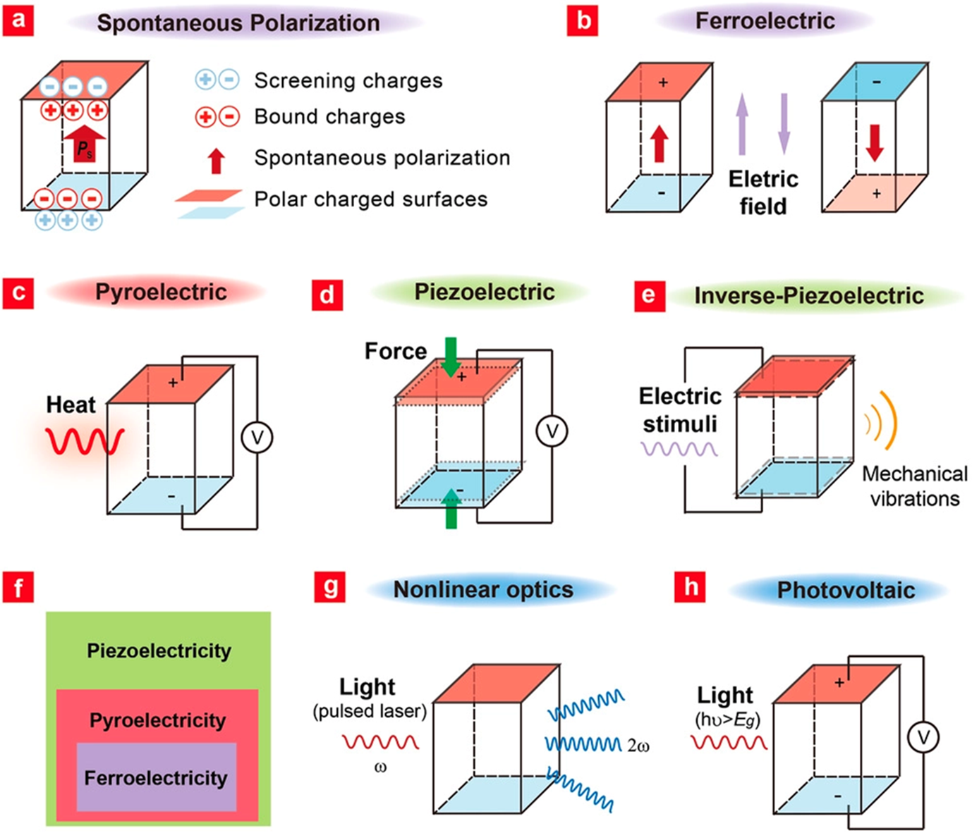
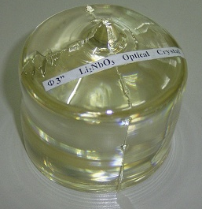
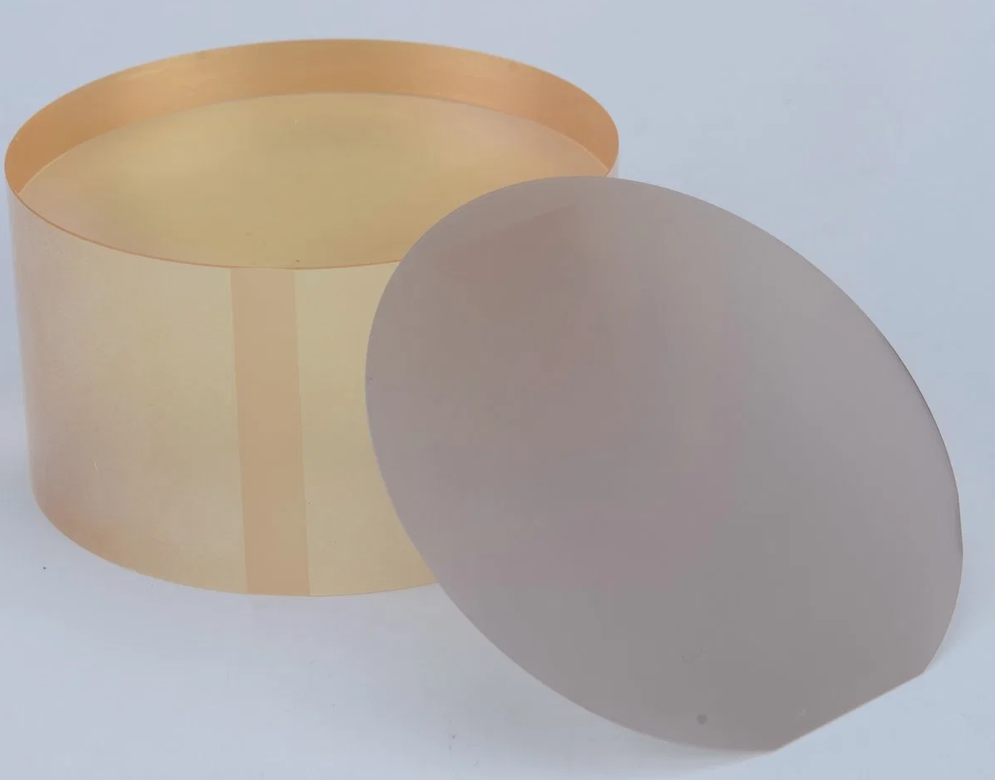
Methods for the electrical excitation of materials with spontaneous polarization
Used materials
Lithium niobate (LiNbO₃)
Lithium tantalate (LiTaO₃)
Density: 4.65 g/cm³
Density: 7.46 g/cm³
Pyroelectric coefficient: about 1 × 10⁻⁸ C/cm²/К
Pyroelectric coefficient: about 2 × 10⁻⁸ C/cm²/К
Dielectric permittivity along polar axis: 43
Dielectric permittivity along polar axis: 44.5
Wang, W., Li, J., Liu, H., & Ge, S. (2020). Advancing Versatile Ferroelectric Materials Toward Biomedical Applications. Advanced Science, 8(1), 2003074.

Slide 3
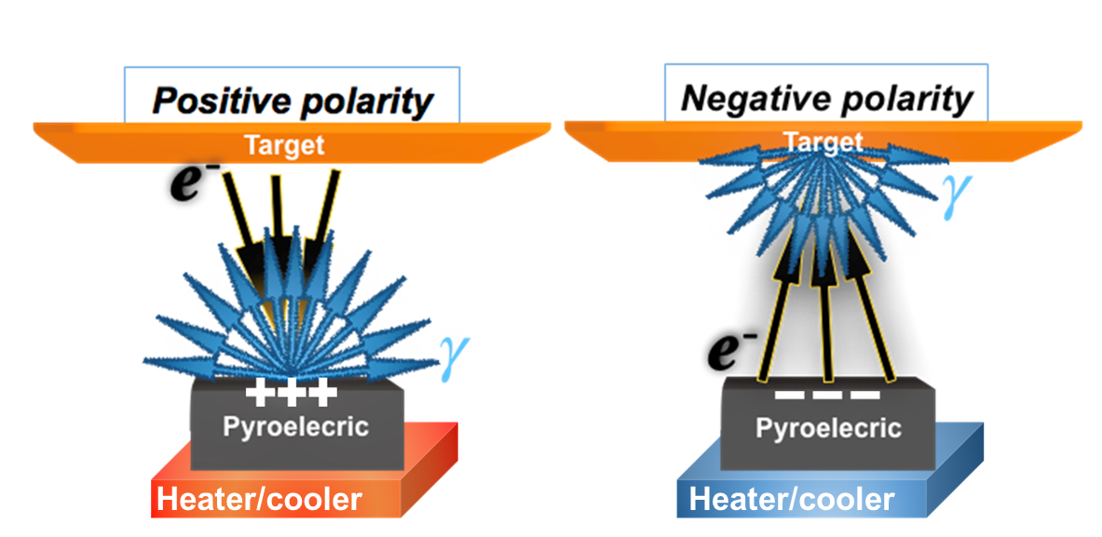
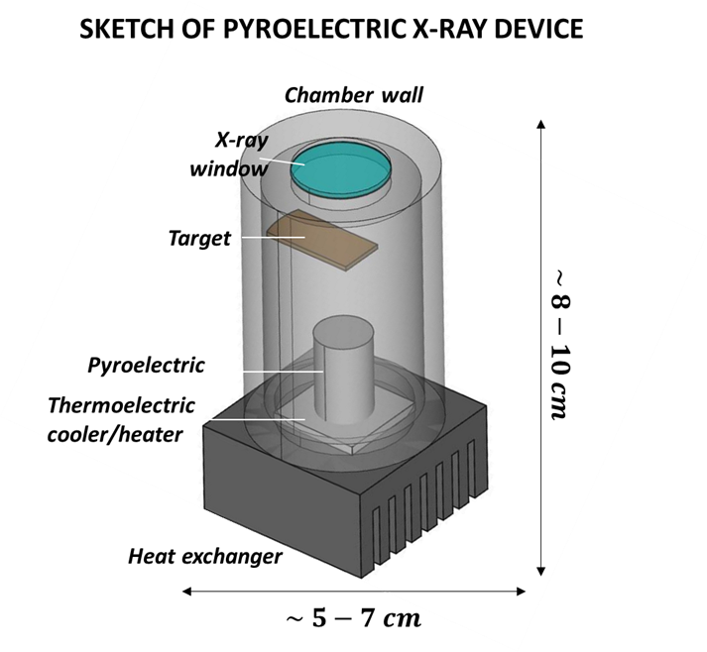
THE SCHEME OF ELECTRON GENERATION IN A PYROELECTRIC ACCELERATOR
Scheme for the generation of electrons and photons based on a charge polarity difference on the surface of a pyroelectric material
The conceptual design of a pyroelectric accelerator
Used pyroelectric materials | Temperature change range | Pressure range | Electron flow current | Electron flow energy | Peak X-ray intensity
Lithium tantalate (LiTaO3) Lithium niobate (LiNbO3) | From 10 °C | Up to 100 mTorr (about 15 Pa) | Up to 1 nA | Up to 200 keV | Up to 10⁹ ph/s in 4π

Slide 4
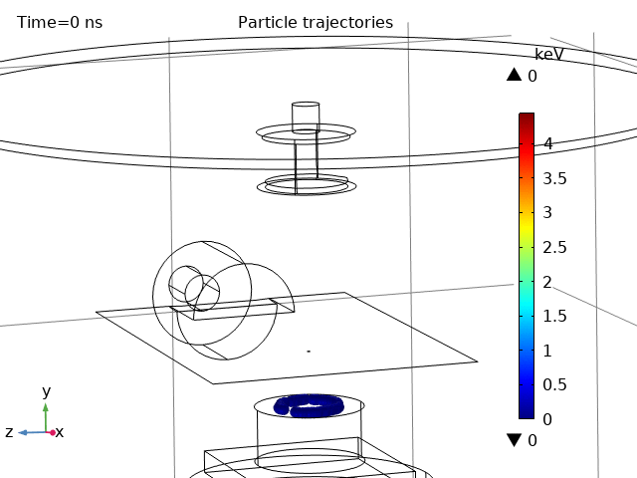
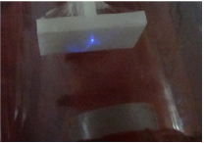
THE ELECTRON FLOW IN A PYROELECTRIC ACCELERATOR (1/2)
SELF-FOCUSING
The spot of the self-focused electron flow emitted from a pyroelectric crystal
(R. Ghaderi and F.A. Davani, Appl. Phys. Lett. 105 (2014) 232906.)
The simulation of self-focused electron flow based on a ring-like charge model

Slide 5
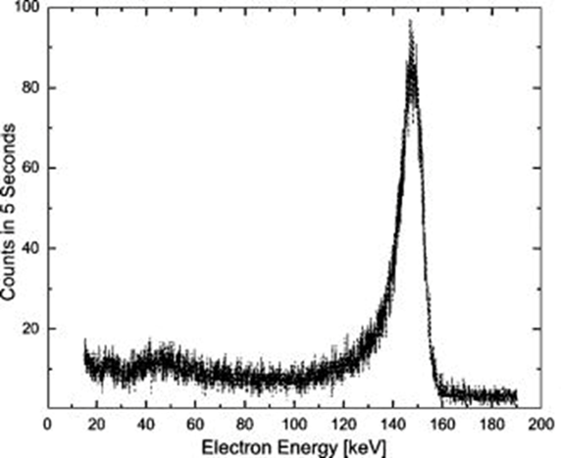
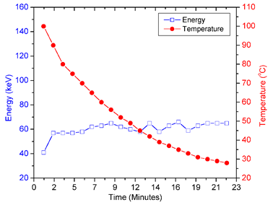
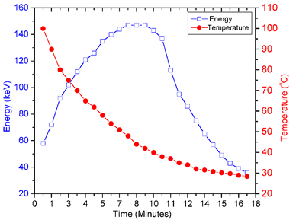
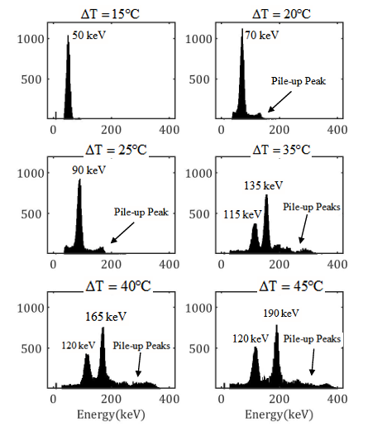
THE ELECTRON FLOW IN A PYROELECTRIC ACCELERATOR (2/2)
J.D. Brownridge et. al., Appl. Phys. Lett. 78 (2001) 1158.)
LONG-TIME QUASIMONOENERGETIC ELECTRON FLOW
S. Mohtashami et. al., JINST 16 (2021) 10017)
stabilization over a prolonged period, but relatively low energy (up to 100 keV)
a high value of 150–250 keV for a short duration (relative to the cycle duration)
The spectrum may contain several quasi-monoenergetic lines that change only slightly over the course of tens of seconds.

Slide 6
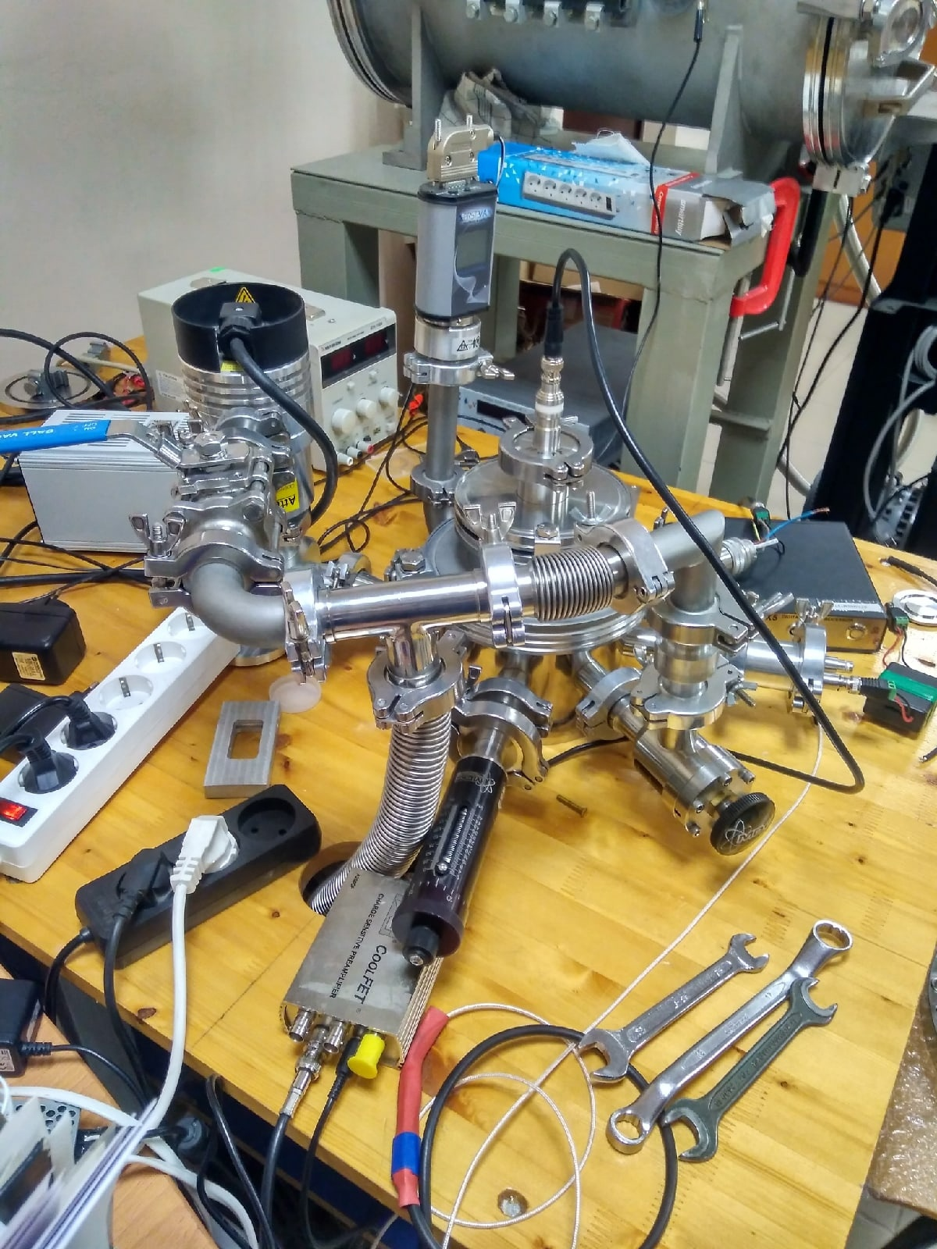
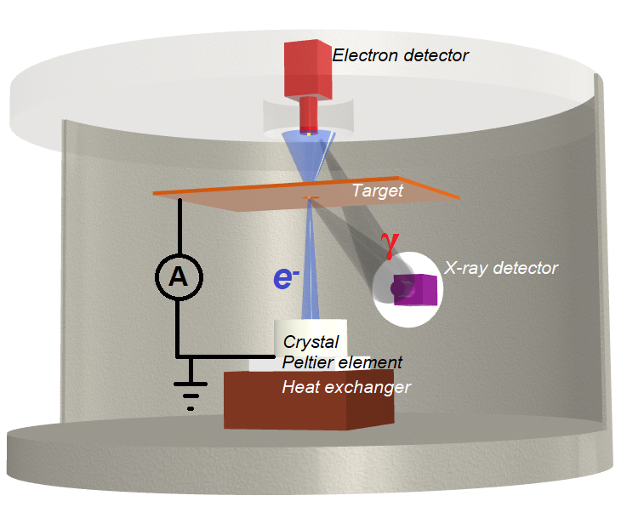
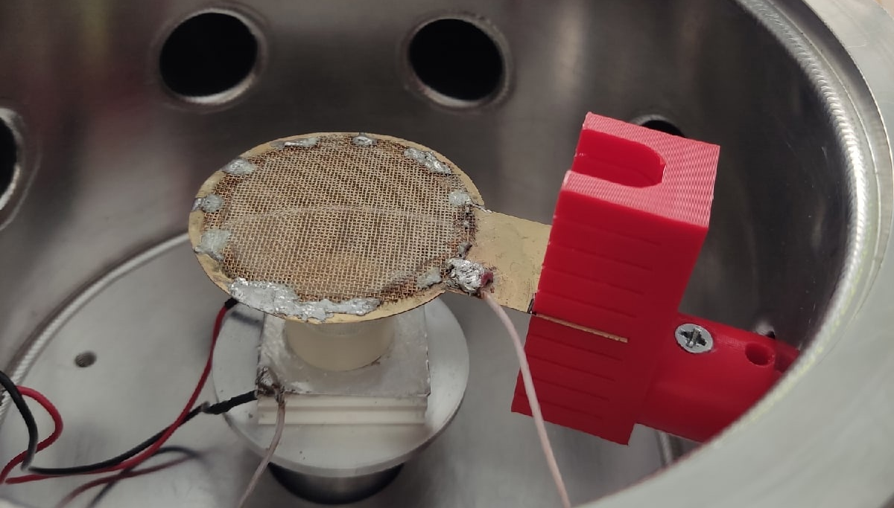
EXPERIMENTAL SETUP IN BELGOROD STATE UNIVERSITY
Standard scheme

Slide 7
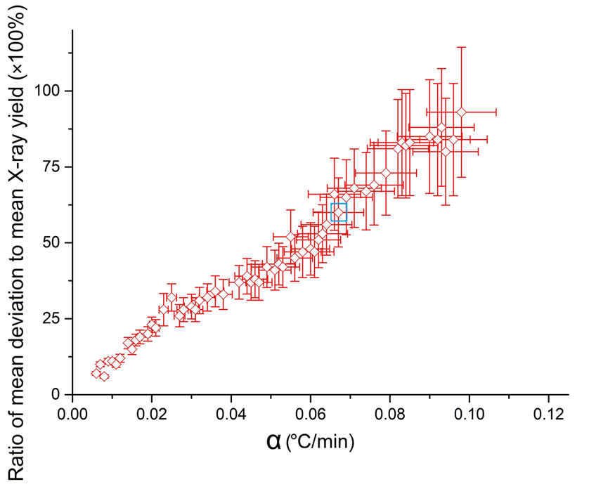
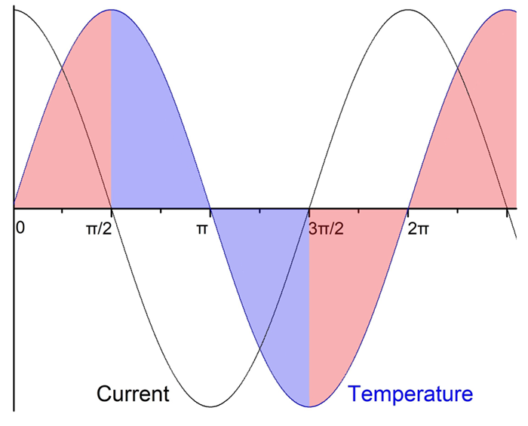
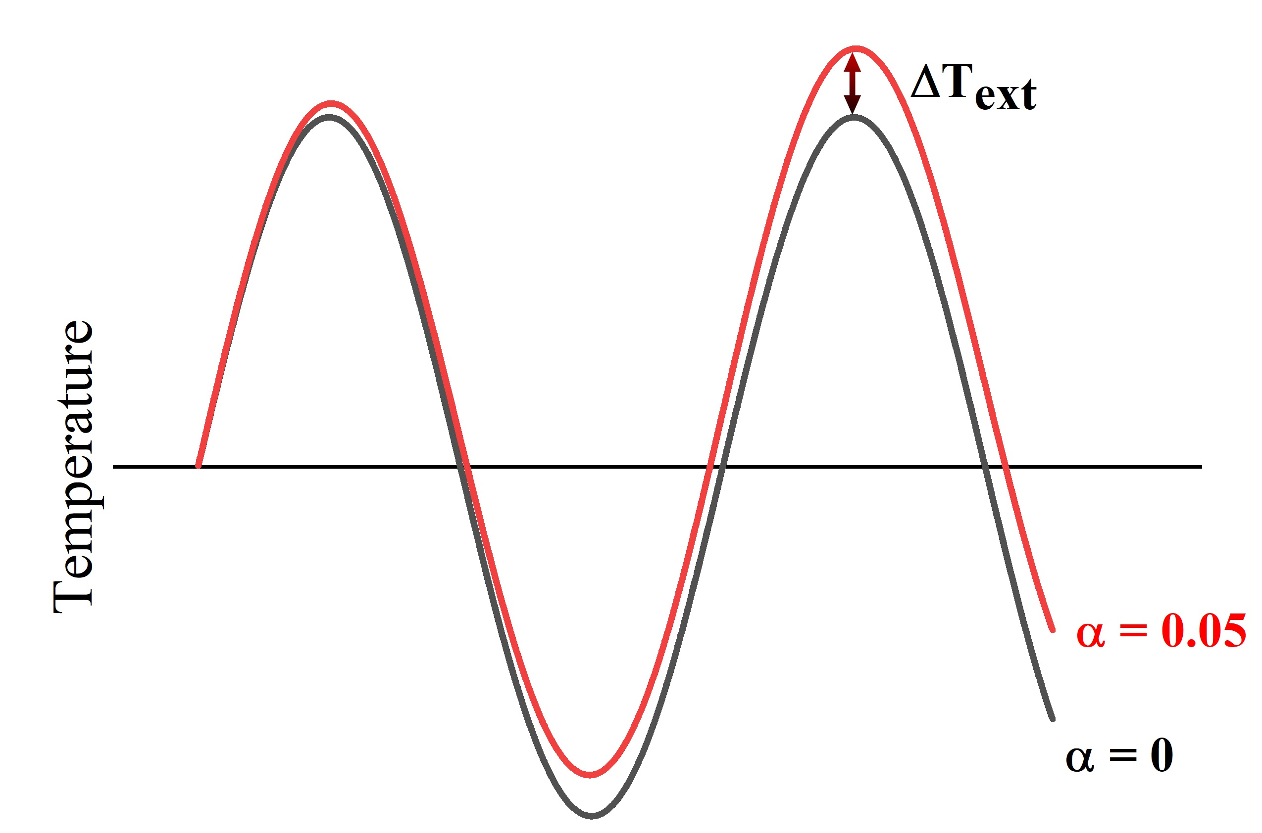




THE INFLUENCE OF TEMPERATURE CHANGE LAW
Periodic variation of temperature
Stable particle area region
A.N. Oleinik, TPL, 2024, No. 6, pp 3-6 (in Russian)
Real law of changing temperature in the experiment
Rate of temperature shift

Slide 8
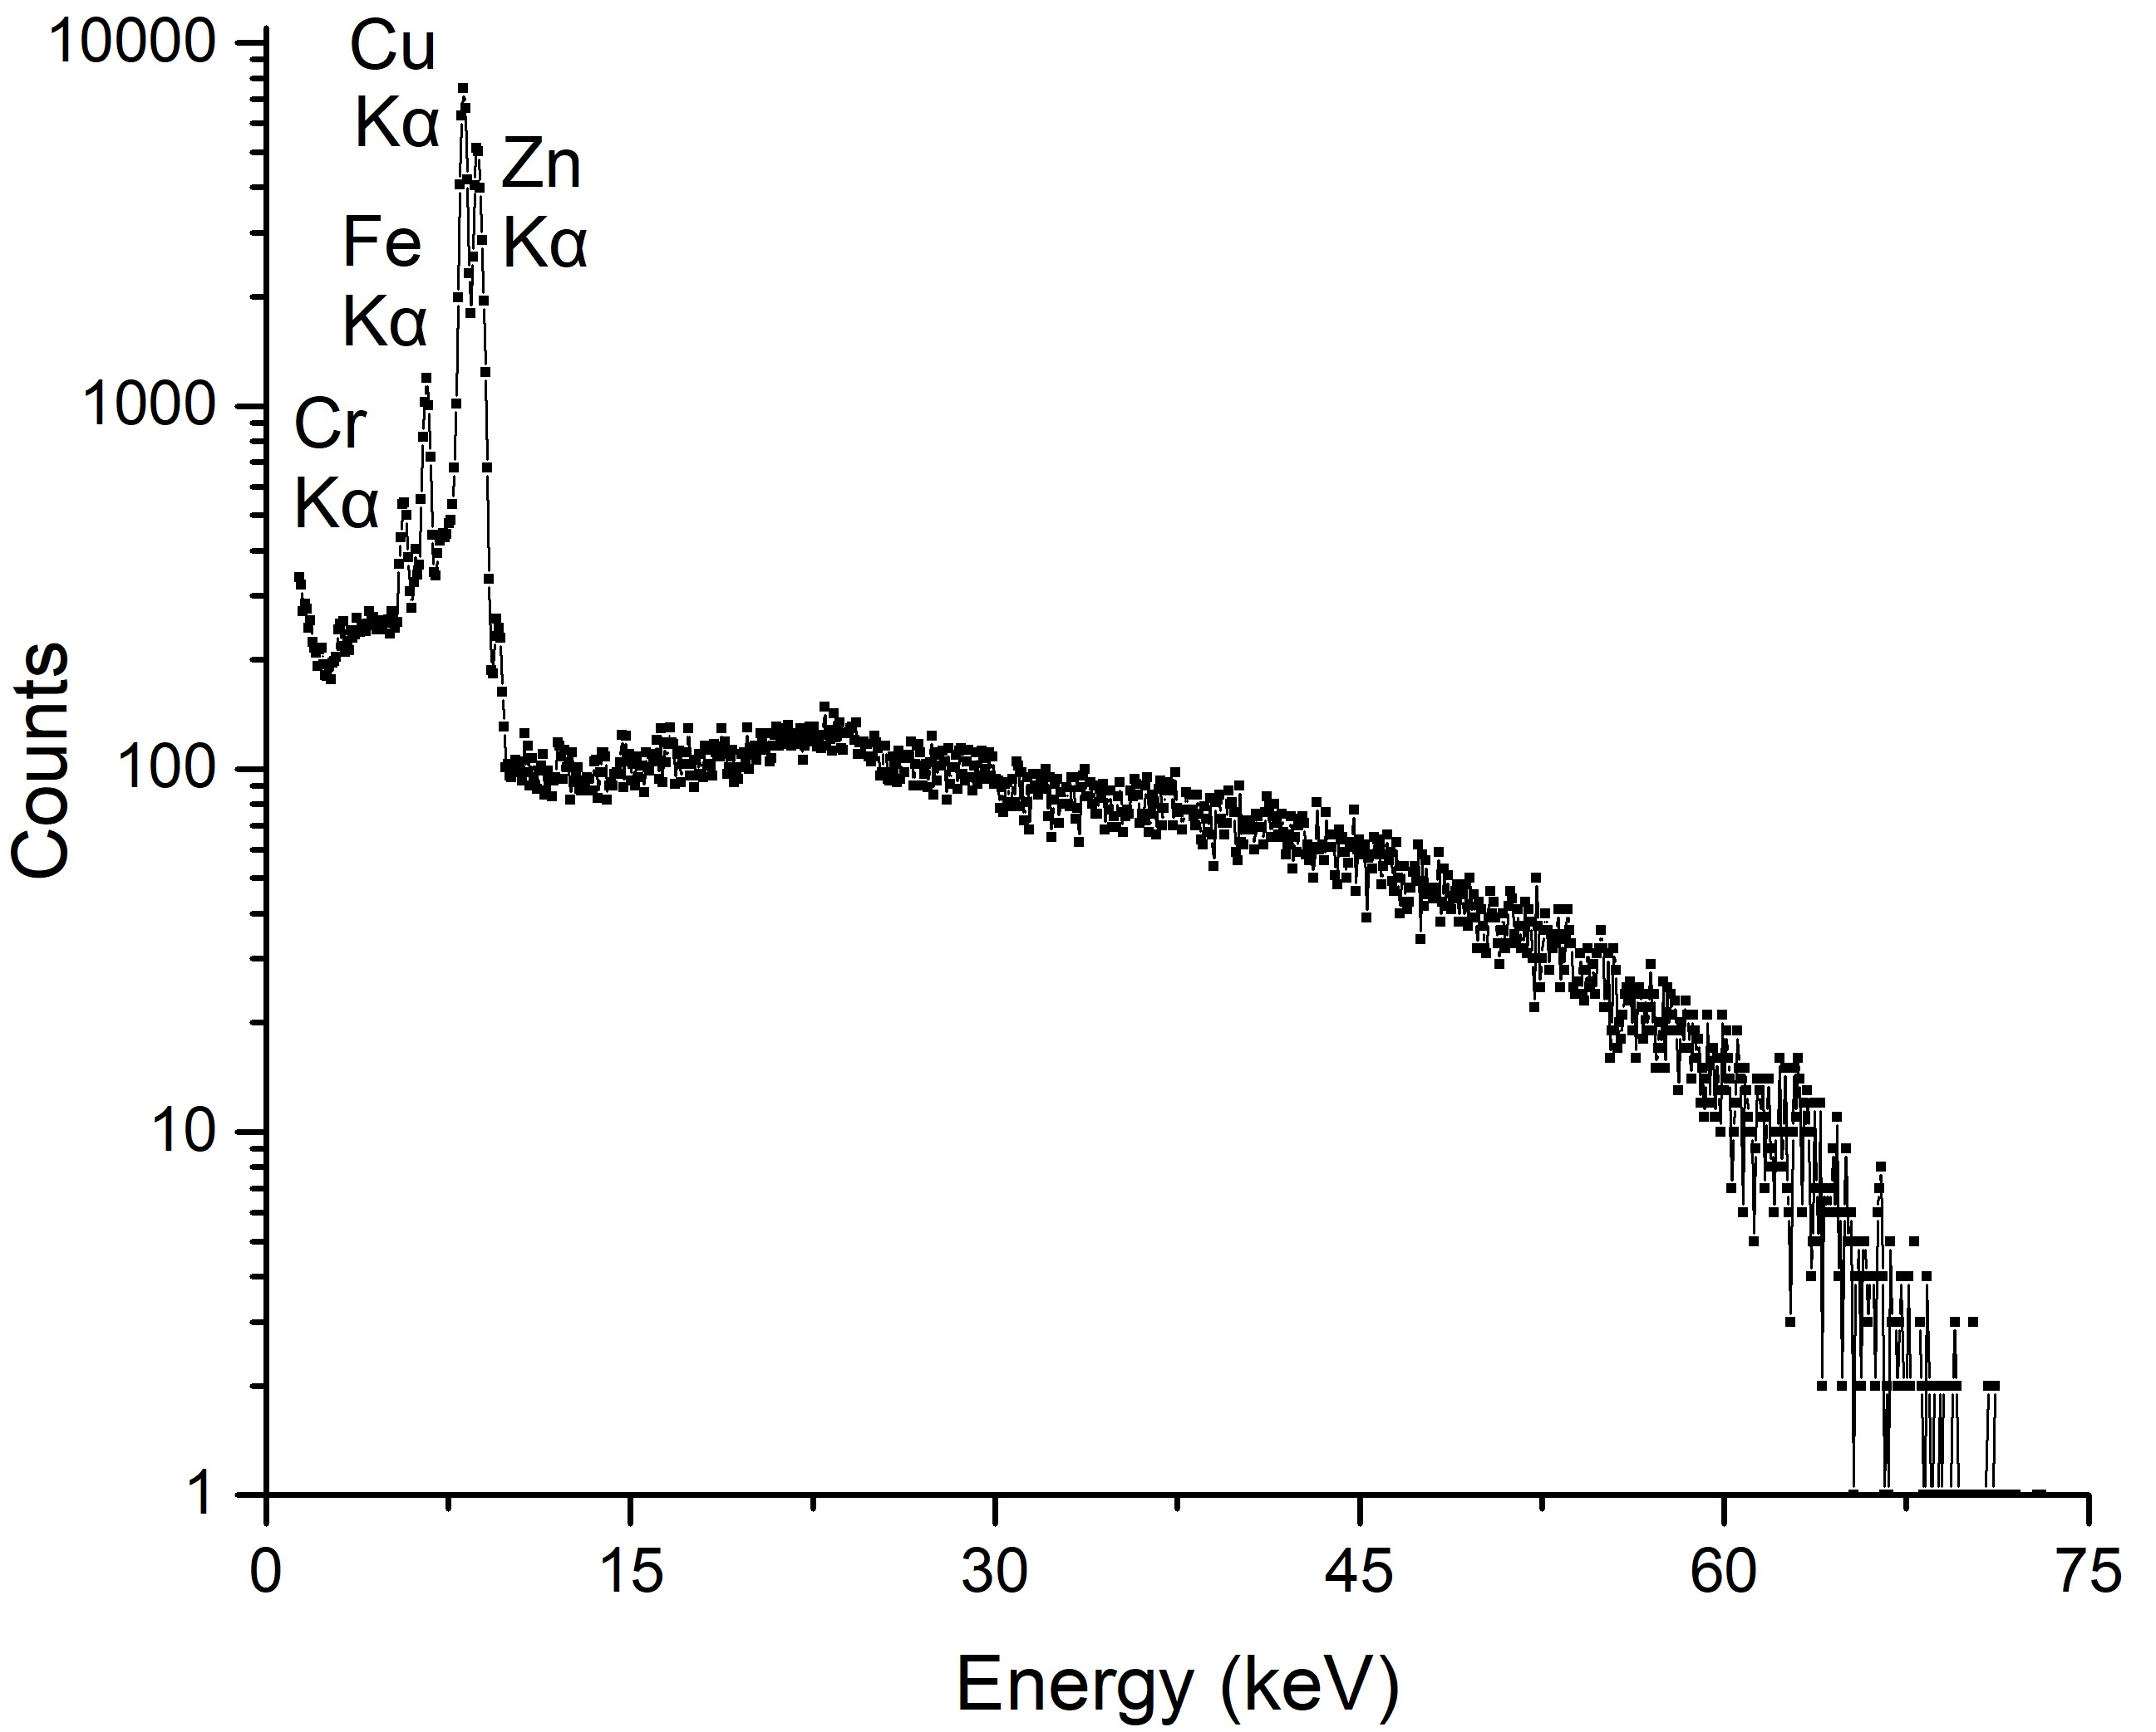
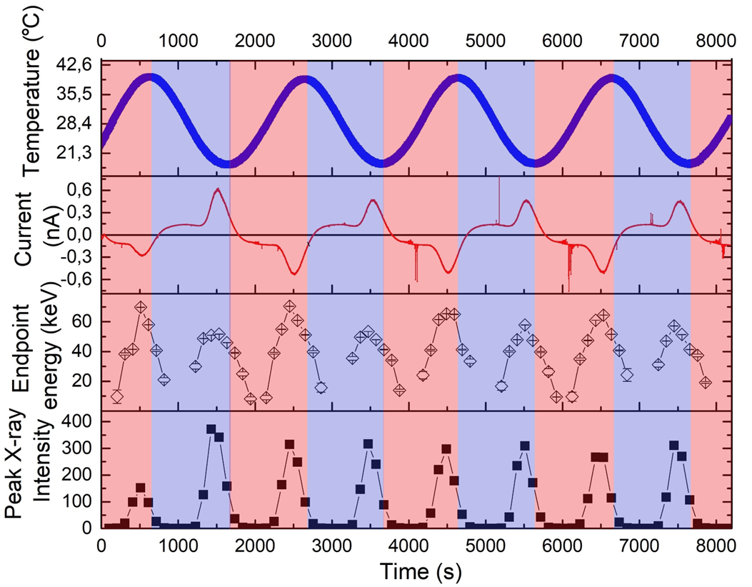
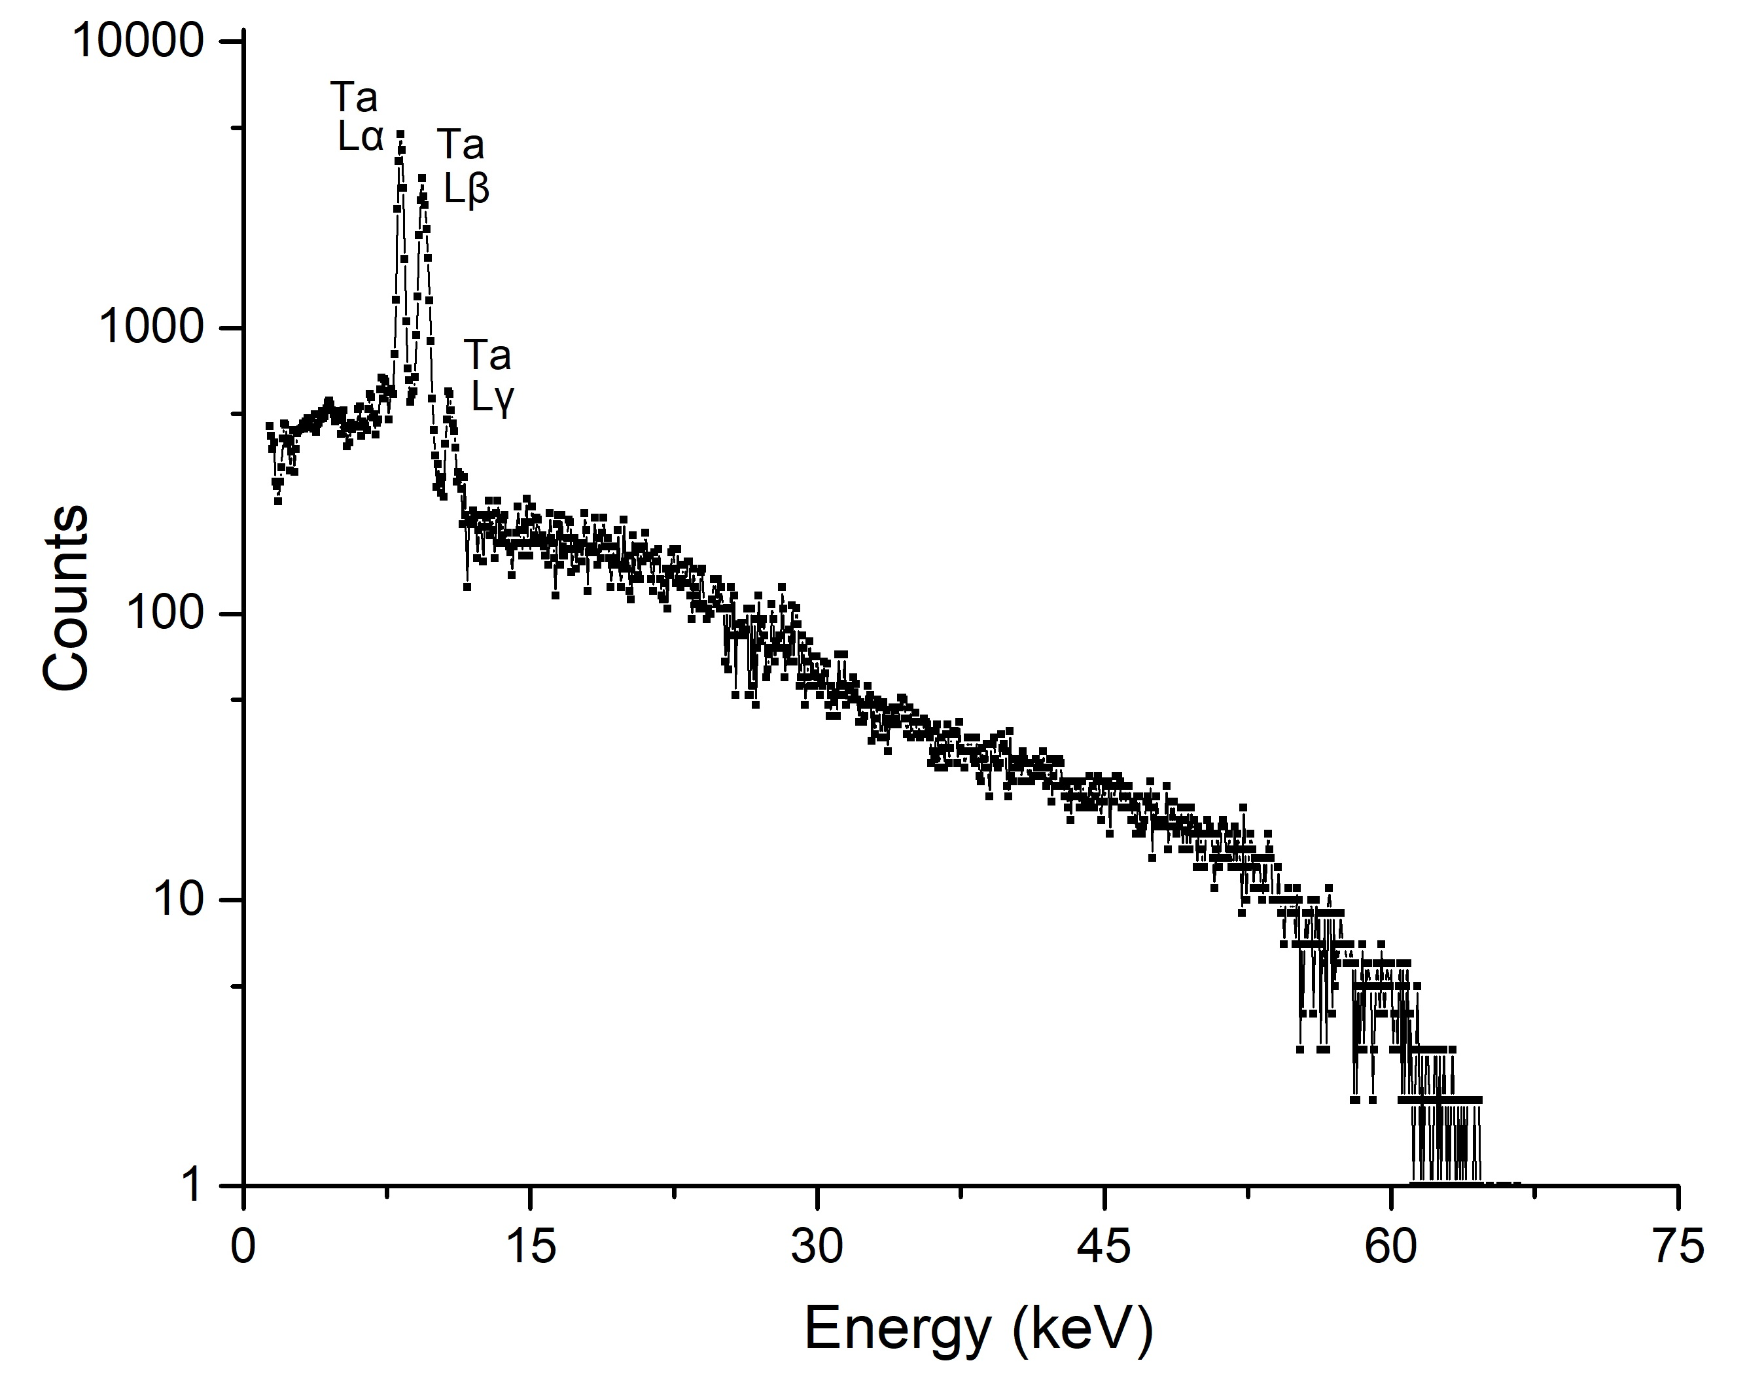
STABLE REGIME OF PARTICLE GENERATION IN A PYROELECTRIC ACCELERATOR
Results of testing under two-hour continuous thermal cycling
negative polarity
positive polarity

Slide 9
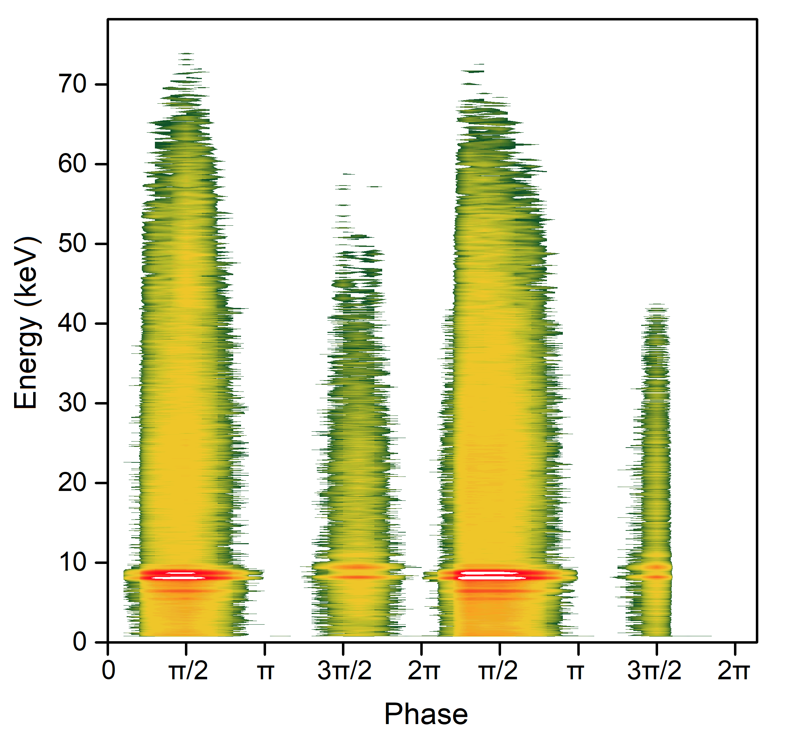
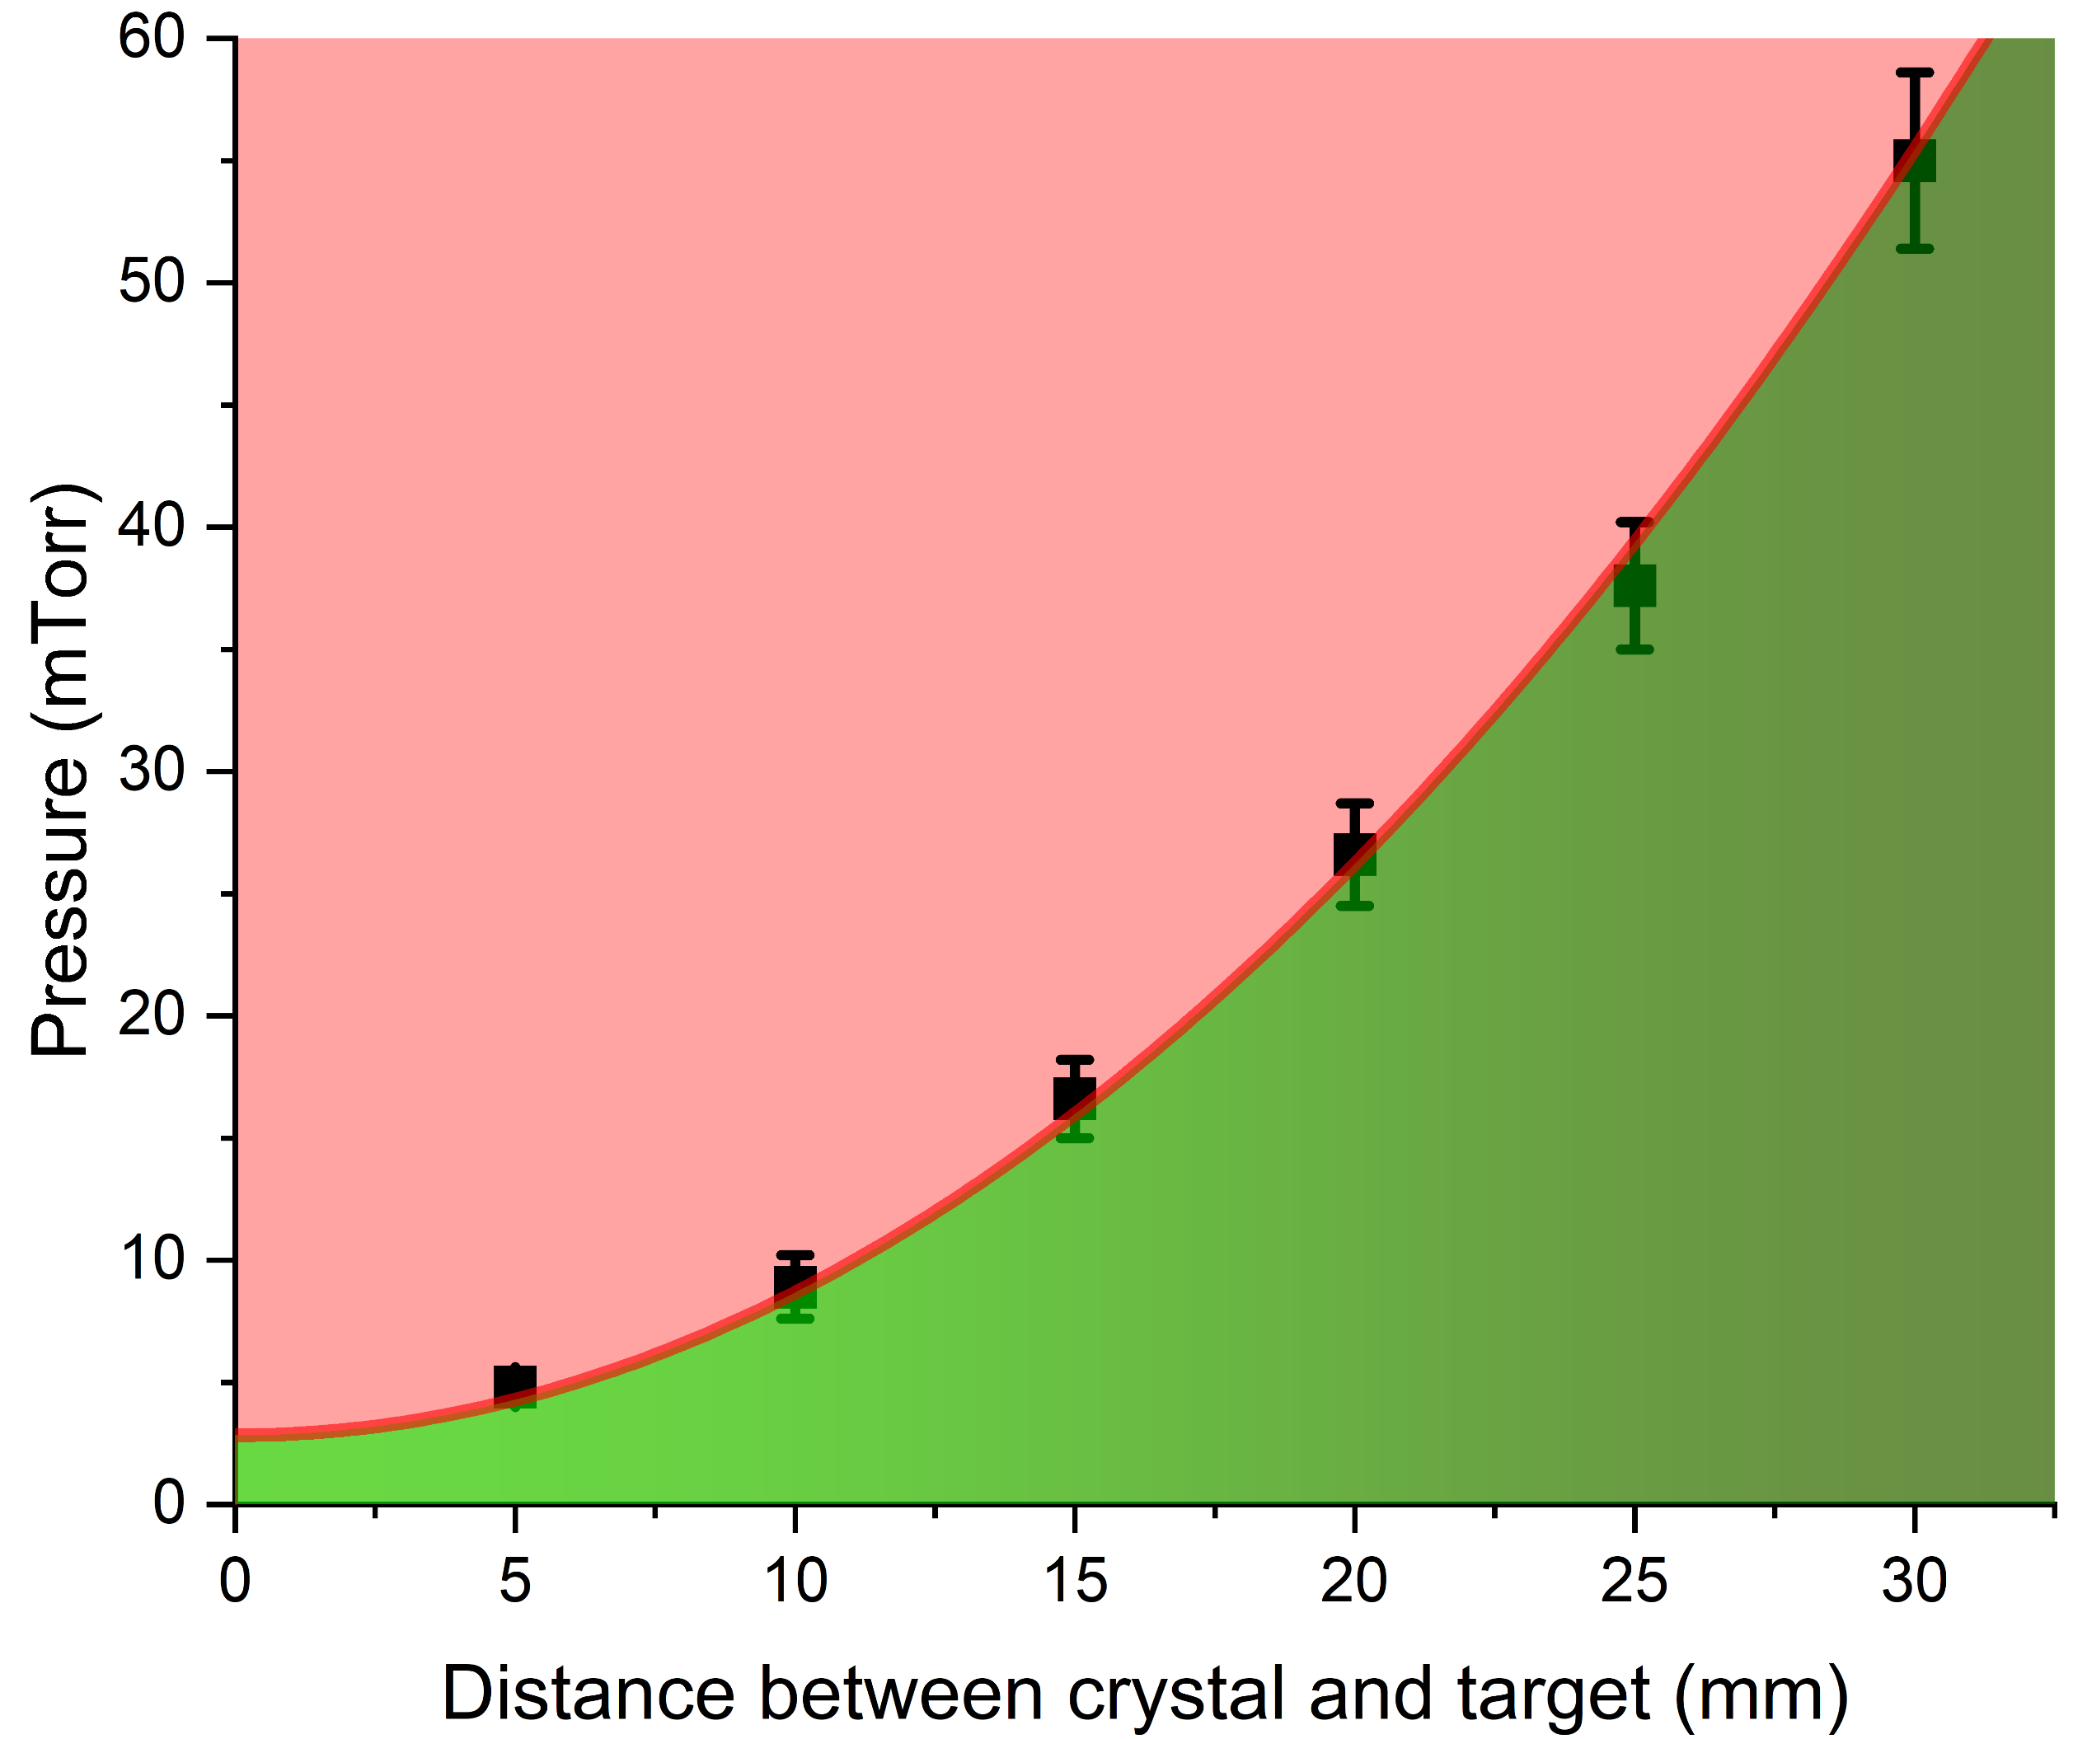
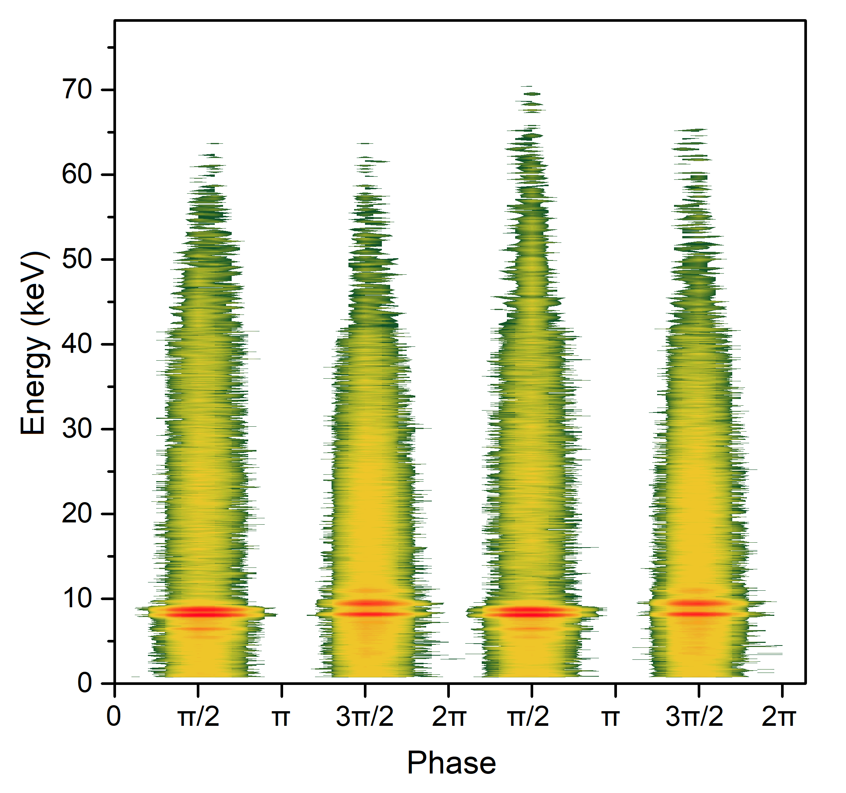
STABLE PARTICLE GENERATION AREA IN A PYROELECTRIC ACCELERATOR
Thermal phase-resolved X-ray spectra
Stability diagram of the pyroelectric accelerator in the residual gas pressure–crystal-to-target distance parameter space
UNSTABLE
Impact
ionization
influence
STABLE

Slide 10
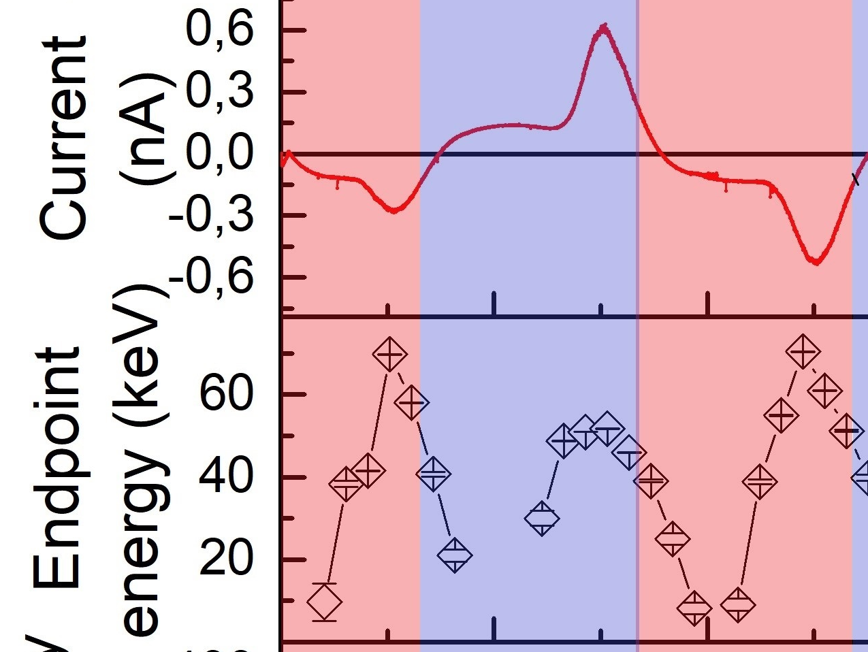
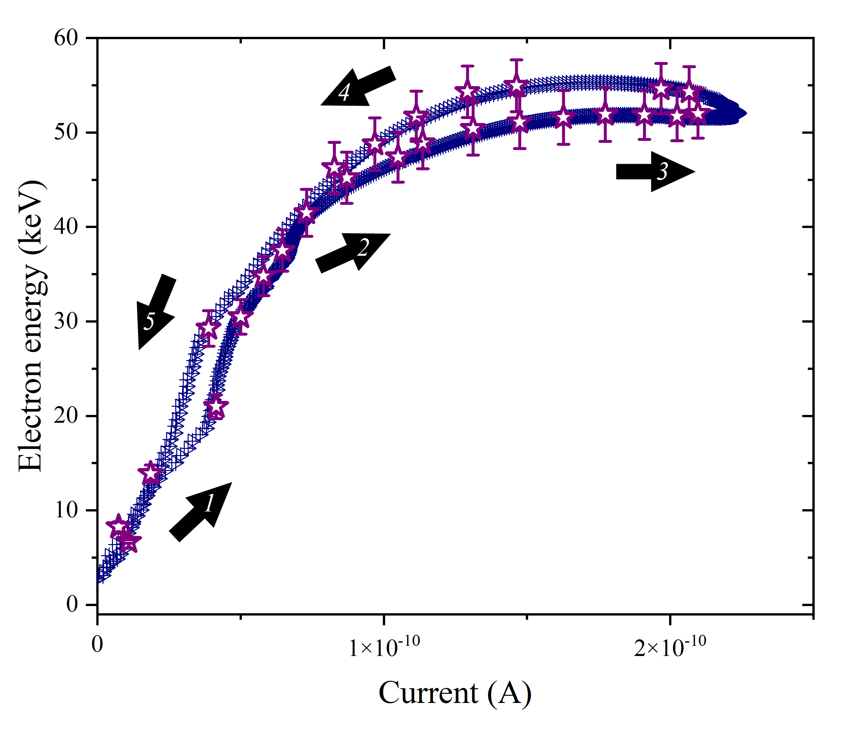
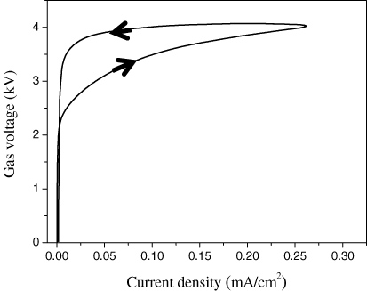
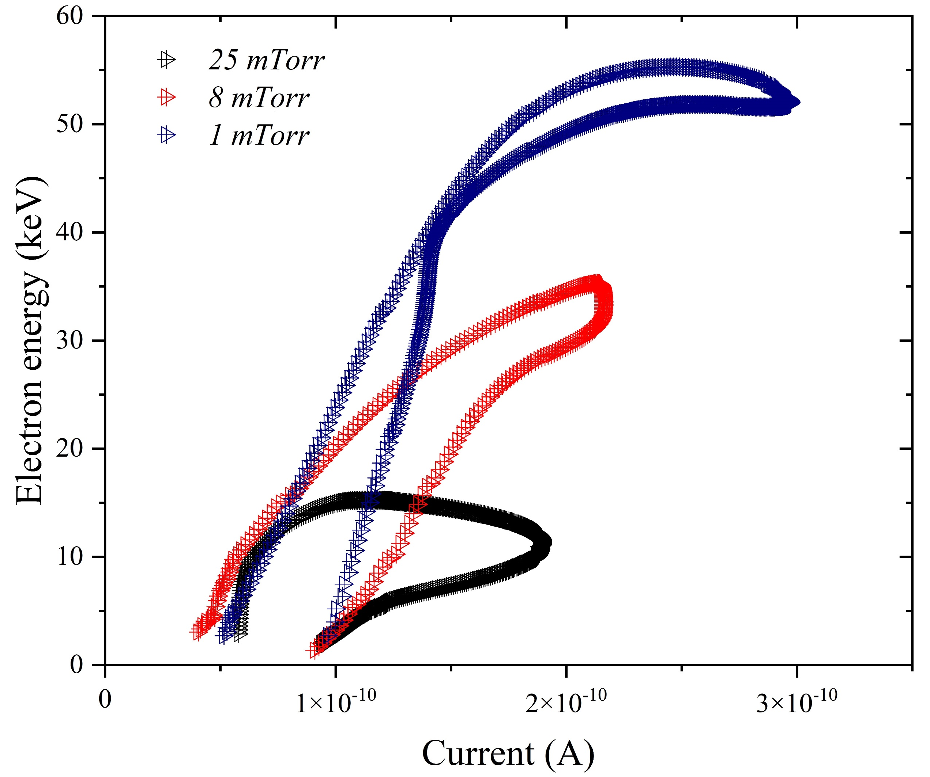
ATYPICAL ELECTRON AVALANCHE IN A PYROELECTRIC ACCELERATOR
There is no mention of these peaks in the literature.
The electron current peaks coincide with the period of maximum X-ray photon intensity and maximum electron energy.
I-V curve of observed discharge
The I-V curves at different pressures of the residual gases
We cannot identify our discharge as a Townsend discharge!
I-V curve of Townsend discharge
Massines, F. et. al. Plasm. Phys. Control. Fusion. 47, B577 (2005).

Slide 11
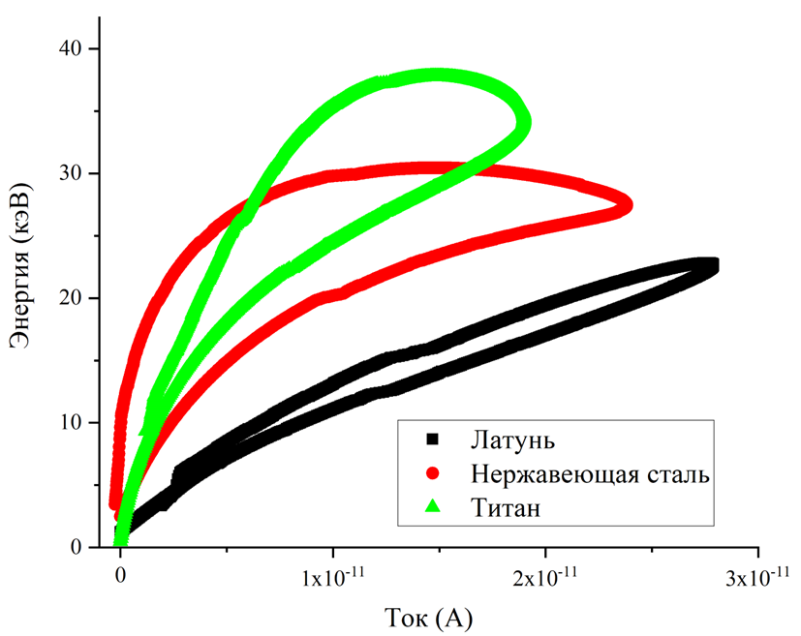
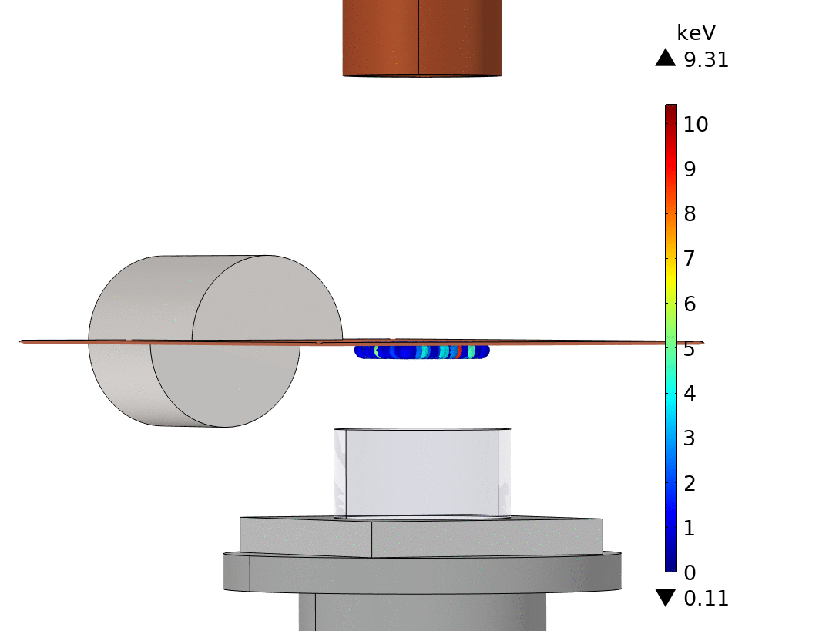

ATYPICAL ELECTRON AVALANCHE IN A PYROELECTRIC ACCELERATOR
I-V curves at different materials of target
Computer simulation of secondary electron motion between target and pyroelectric crystal
Energy (keV)
Brass
Steel
Titanium
Current (A)
А. Oleinik, M.E. Gilts, et.al., Europhysics Letters, (2023) 142 34001
11

Slide 12
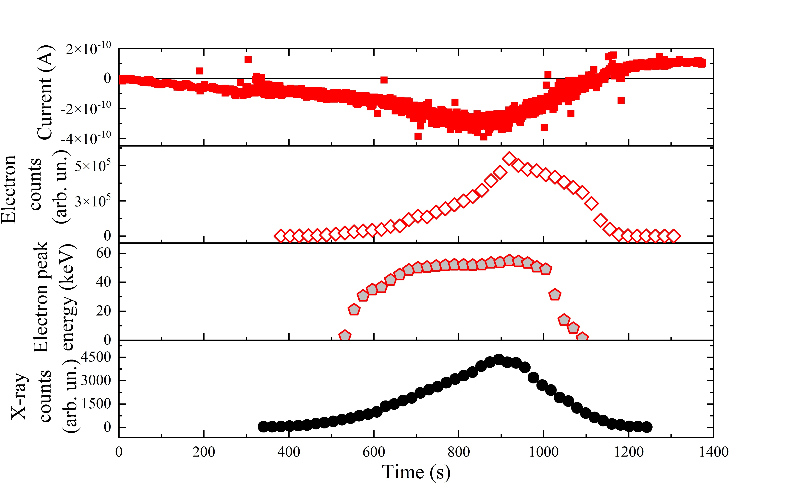
CORRELATION BETWEEN AVALANCHE DISCHARGE AND LONG-TERM STABILUTY OF ELECTRON SPECTRUM
additional electron wave
long-term monoenergeticity

Slide 13
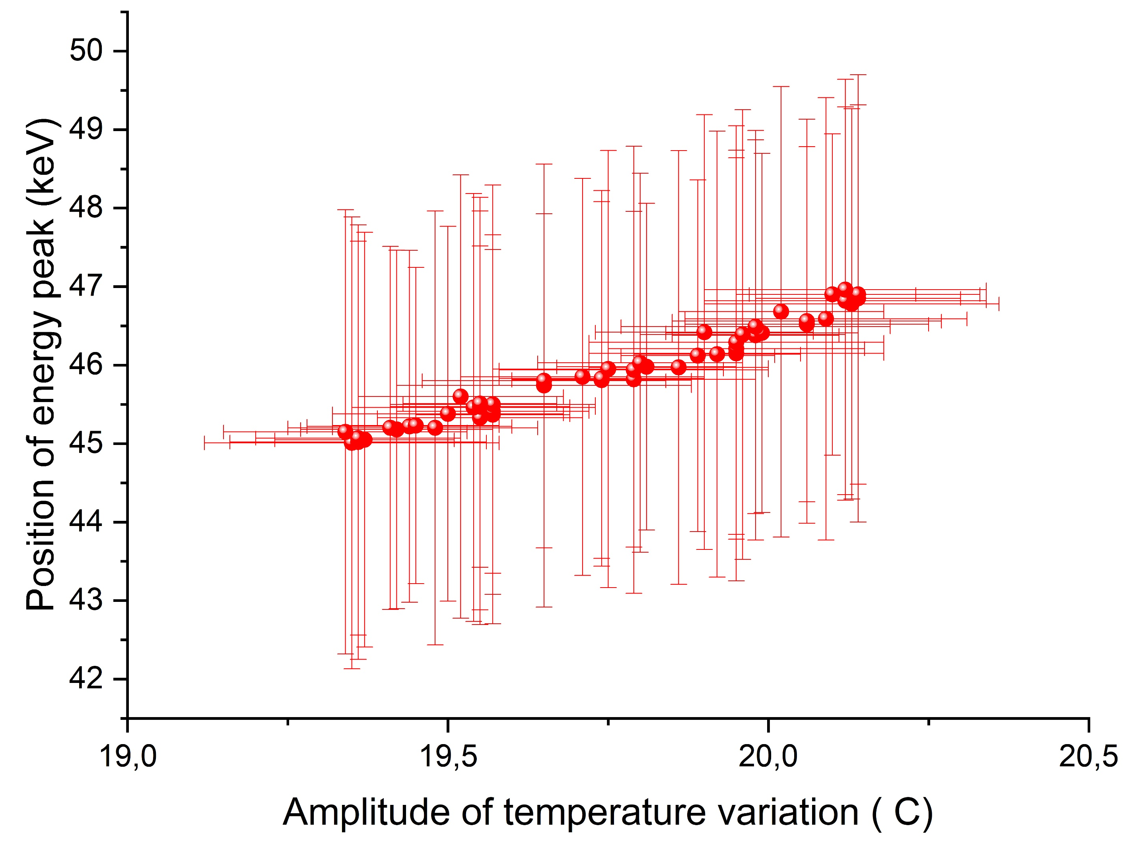
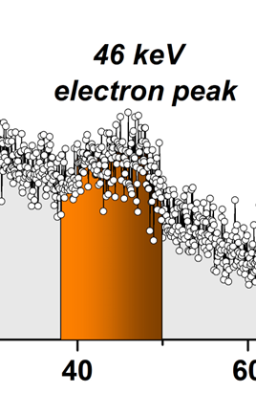
APPLICABILITY FOR CALIBRATION OF PARTICLE DETECTORS
It was performed over 50 thermal cycles at next conditions:
- LiTaO₃ single crystal, 20x20x10 (z) mm, cylinder shape;
- Brass target, 50x50x0.4 mm with hole of 0.3 mm diameter;
- Pressure range is 1.5-5 mTorr
- Temperature variation amplitude is 19.3-20.1 °C
- Ortec-CR-012-025-100 surface-barrier particle detector was used to measure electron flux.
°

Slide 14
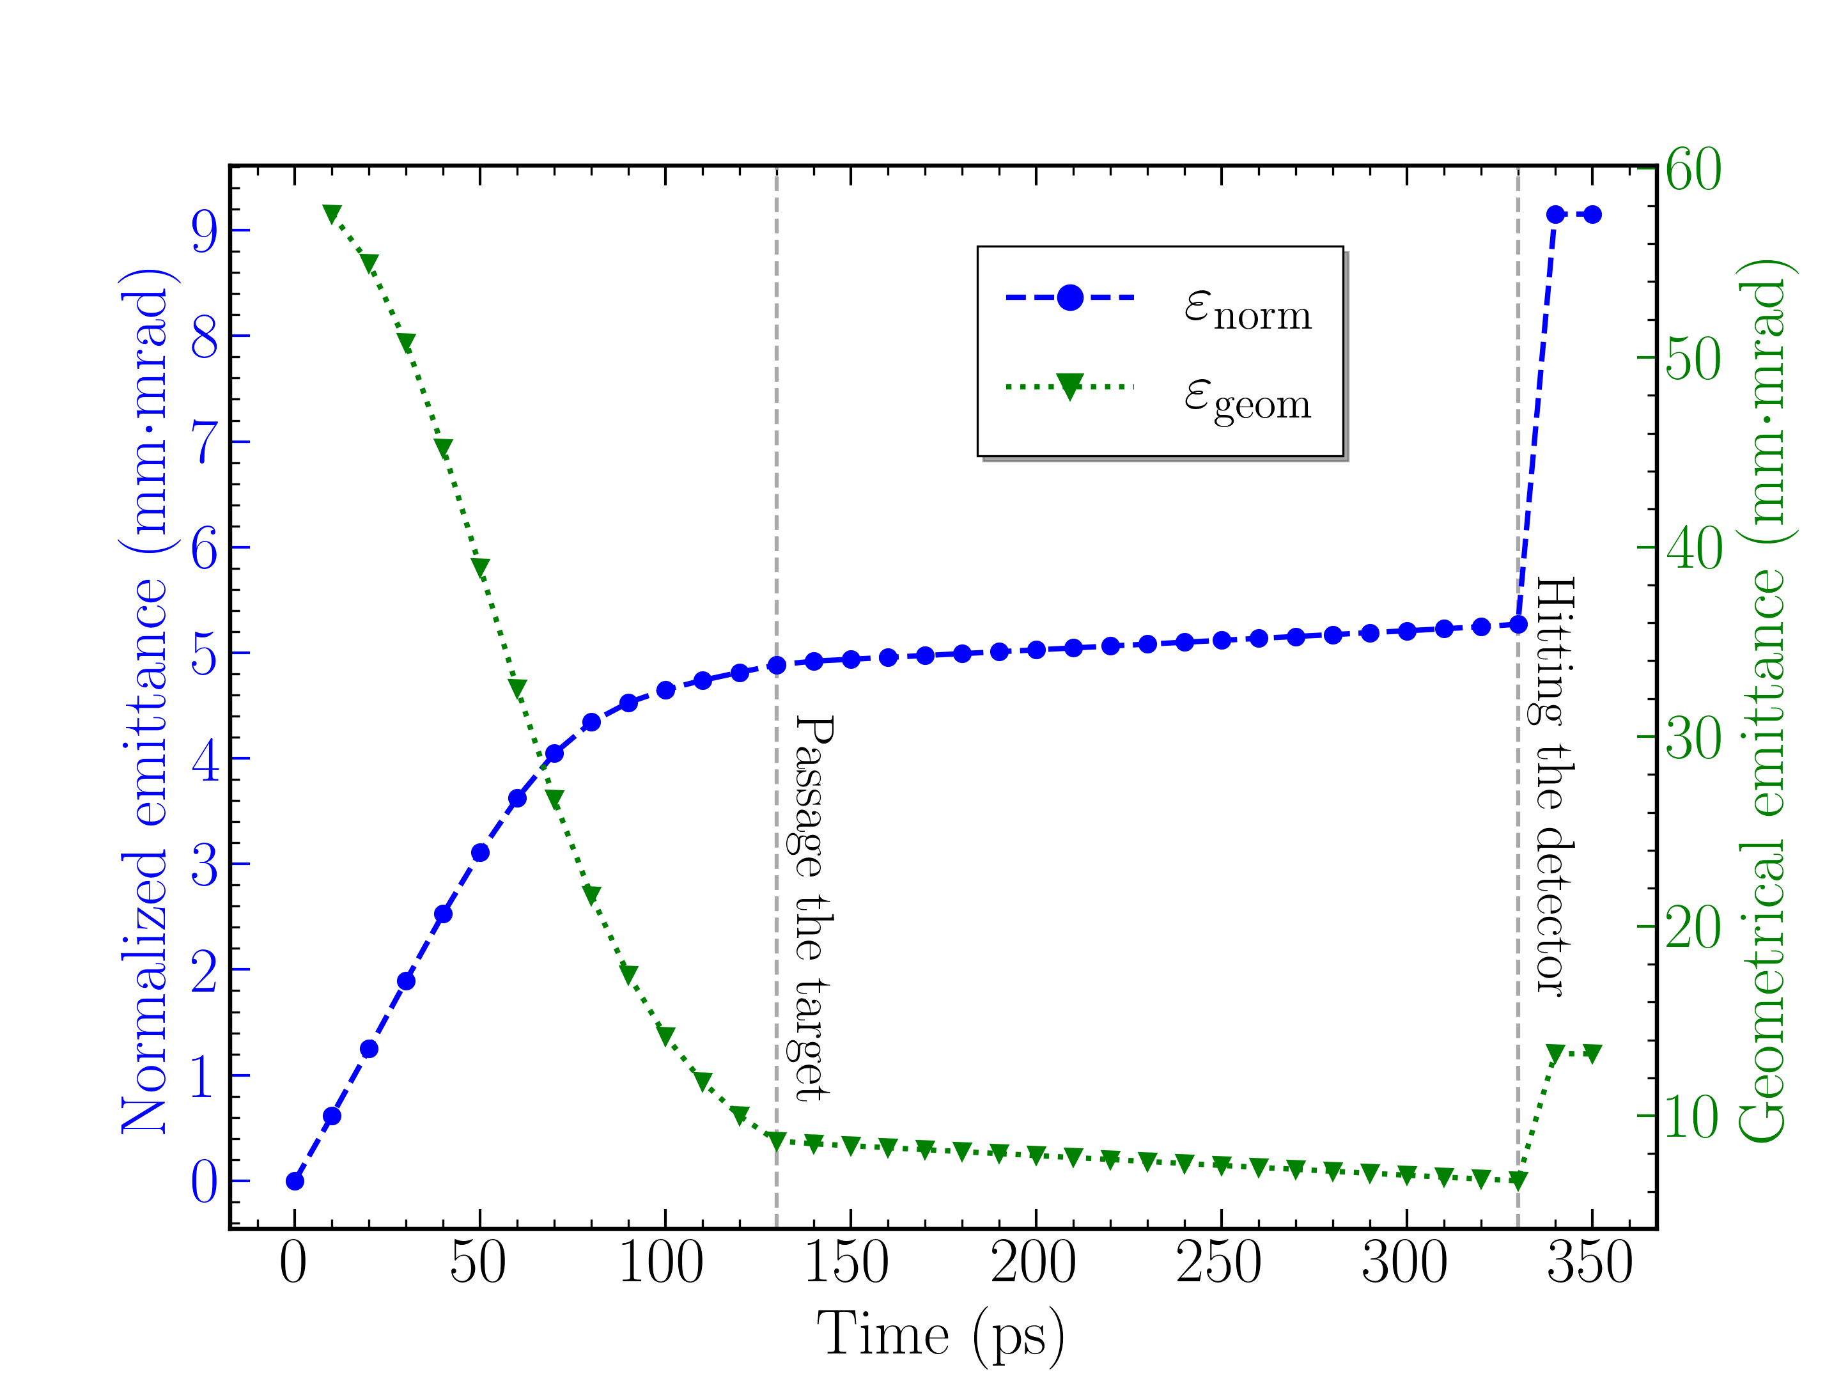
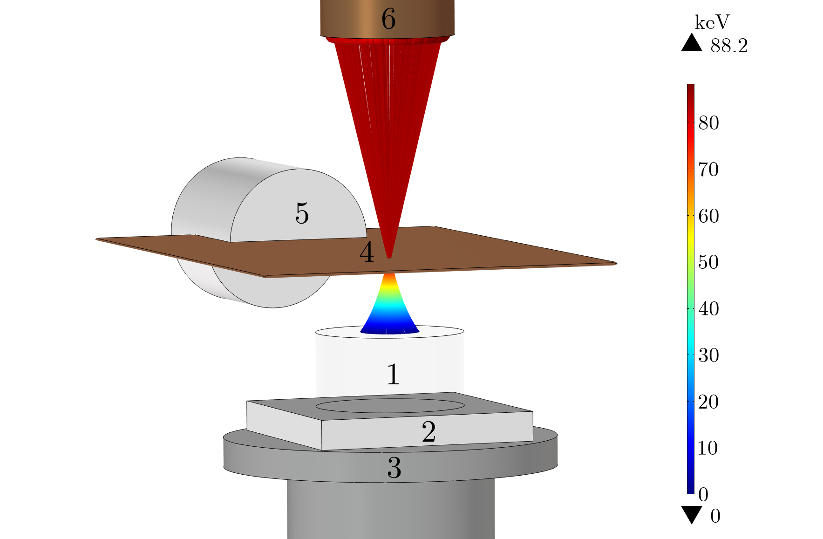
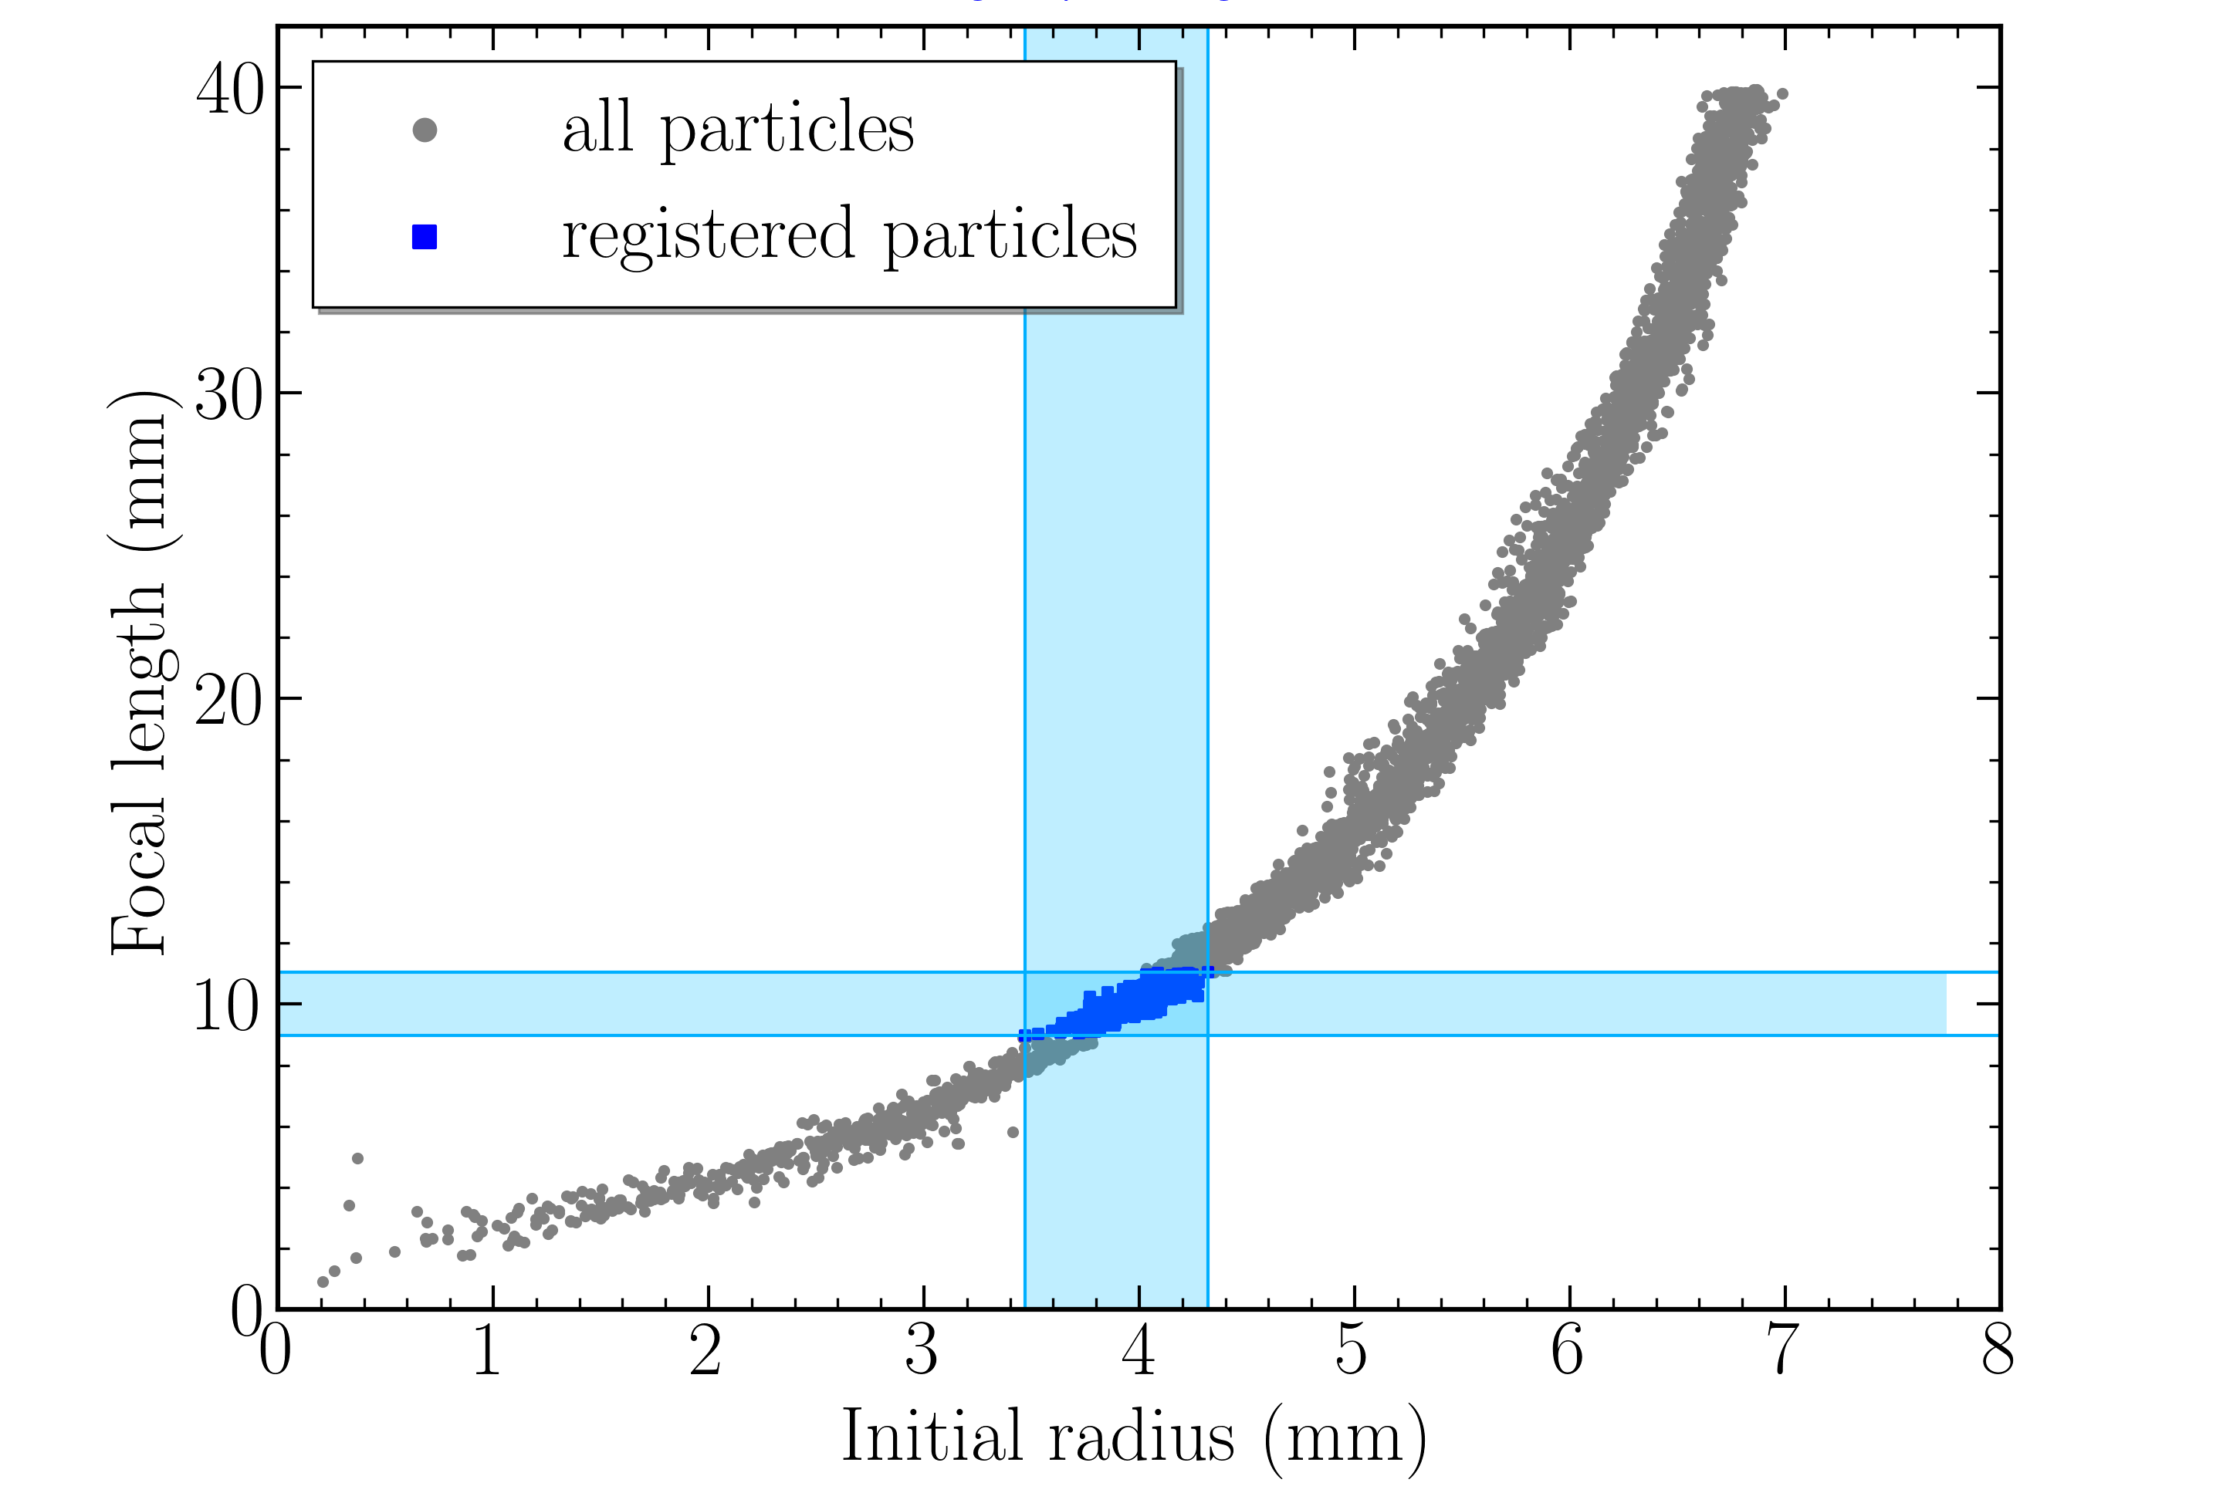

COMPUTER MODELING OF ELECTRON FLUX IN A PYROELECTRIC ACCELERATOR
Trajectories of primary electron flux in geometry of an experiment
Dynamic of emittance of electron flux
The dependence of focal point on radial coordinate of electron emission
P.G. Shapovalov et.al., Journal of Instrumentation 19 C09001 2024

Slide 15
CONCLUSION
There is an area with stable and reproducible electron generation (in space “pressure-distance”) with minimized risk of electric breakdown (at certain temperature variation level)
This area is limited by an influence of impact ionization, the role of secondary electron emission is not so unambiguous
The position of energy peak of electron flux is very sensitive to value of pressure, amplitude of temperature variation, but it is reproducible and can be controllable
Devices based on pyroelectric accelerator concept can be implemented as calibration instruments for different electron detectors with tunable energy peak about several tens of keV

Slide 16



A. Oleinik, et. al. J. App. Phys., 132, 204101 (2022).
А. Oleinik, M.E. Gilts, et.al., Europhysics Letters, (2023) 142 34001
THANK FOR YOUR ATTENTION!
A.N. Oleinik, et.al., Nuclear Instruments and Methods in Physics Research A 1065 (2024) 169537
P.G. Shapovalov et.al., Journal of Instrumentation 19 C09001 2024
Karataev, P., Ali, M., Fedorov, K. et al. Quasi-continuous X-ray generation in LiTaO3-based pyroelectric accelerator driven by periodically varying temperature. Sci Rep 15, 31209 (2025).
The research was supported by a grant from the Russian Science Foundation (Project No. 26–72–10002)

